Slide 1

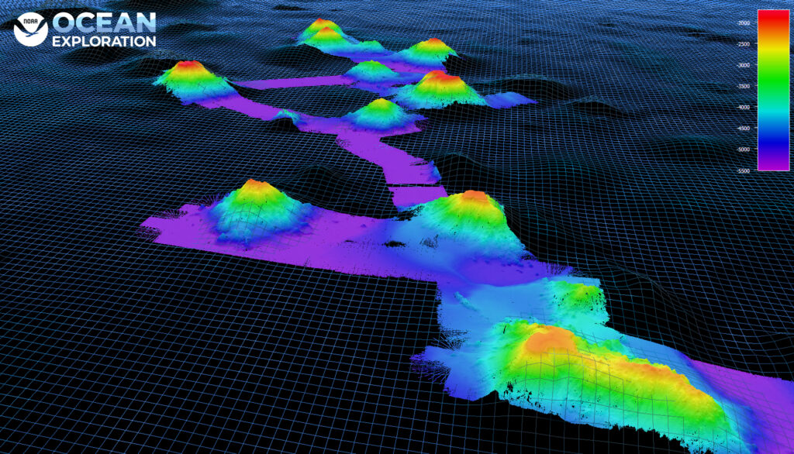
Investigation:
Formation of Seamounts and Island Chains

Slide 2
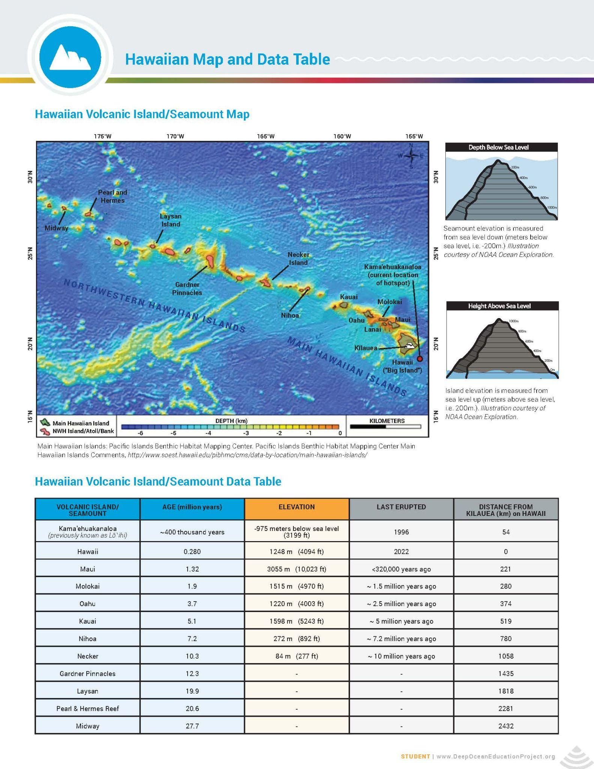
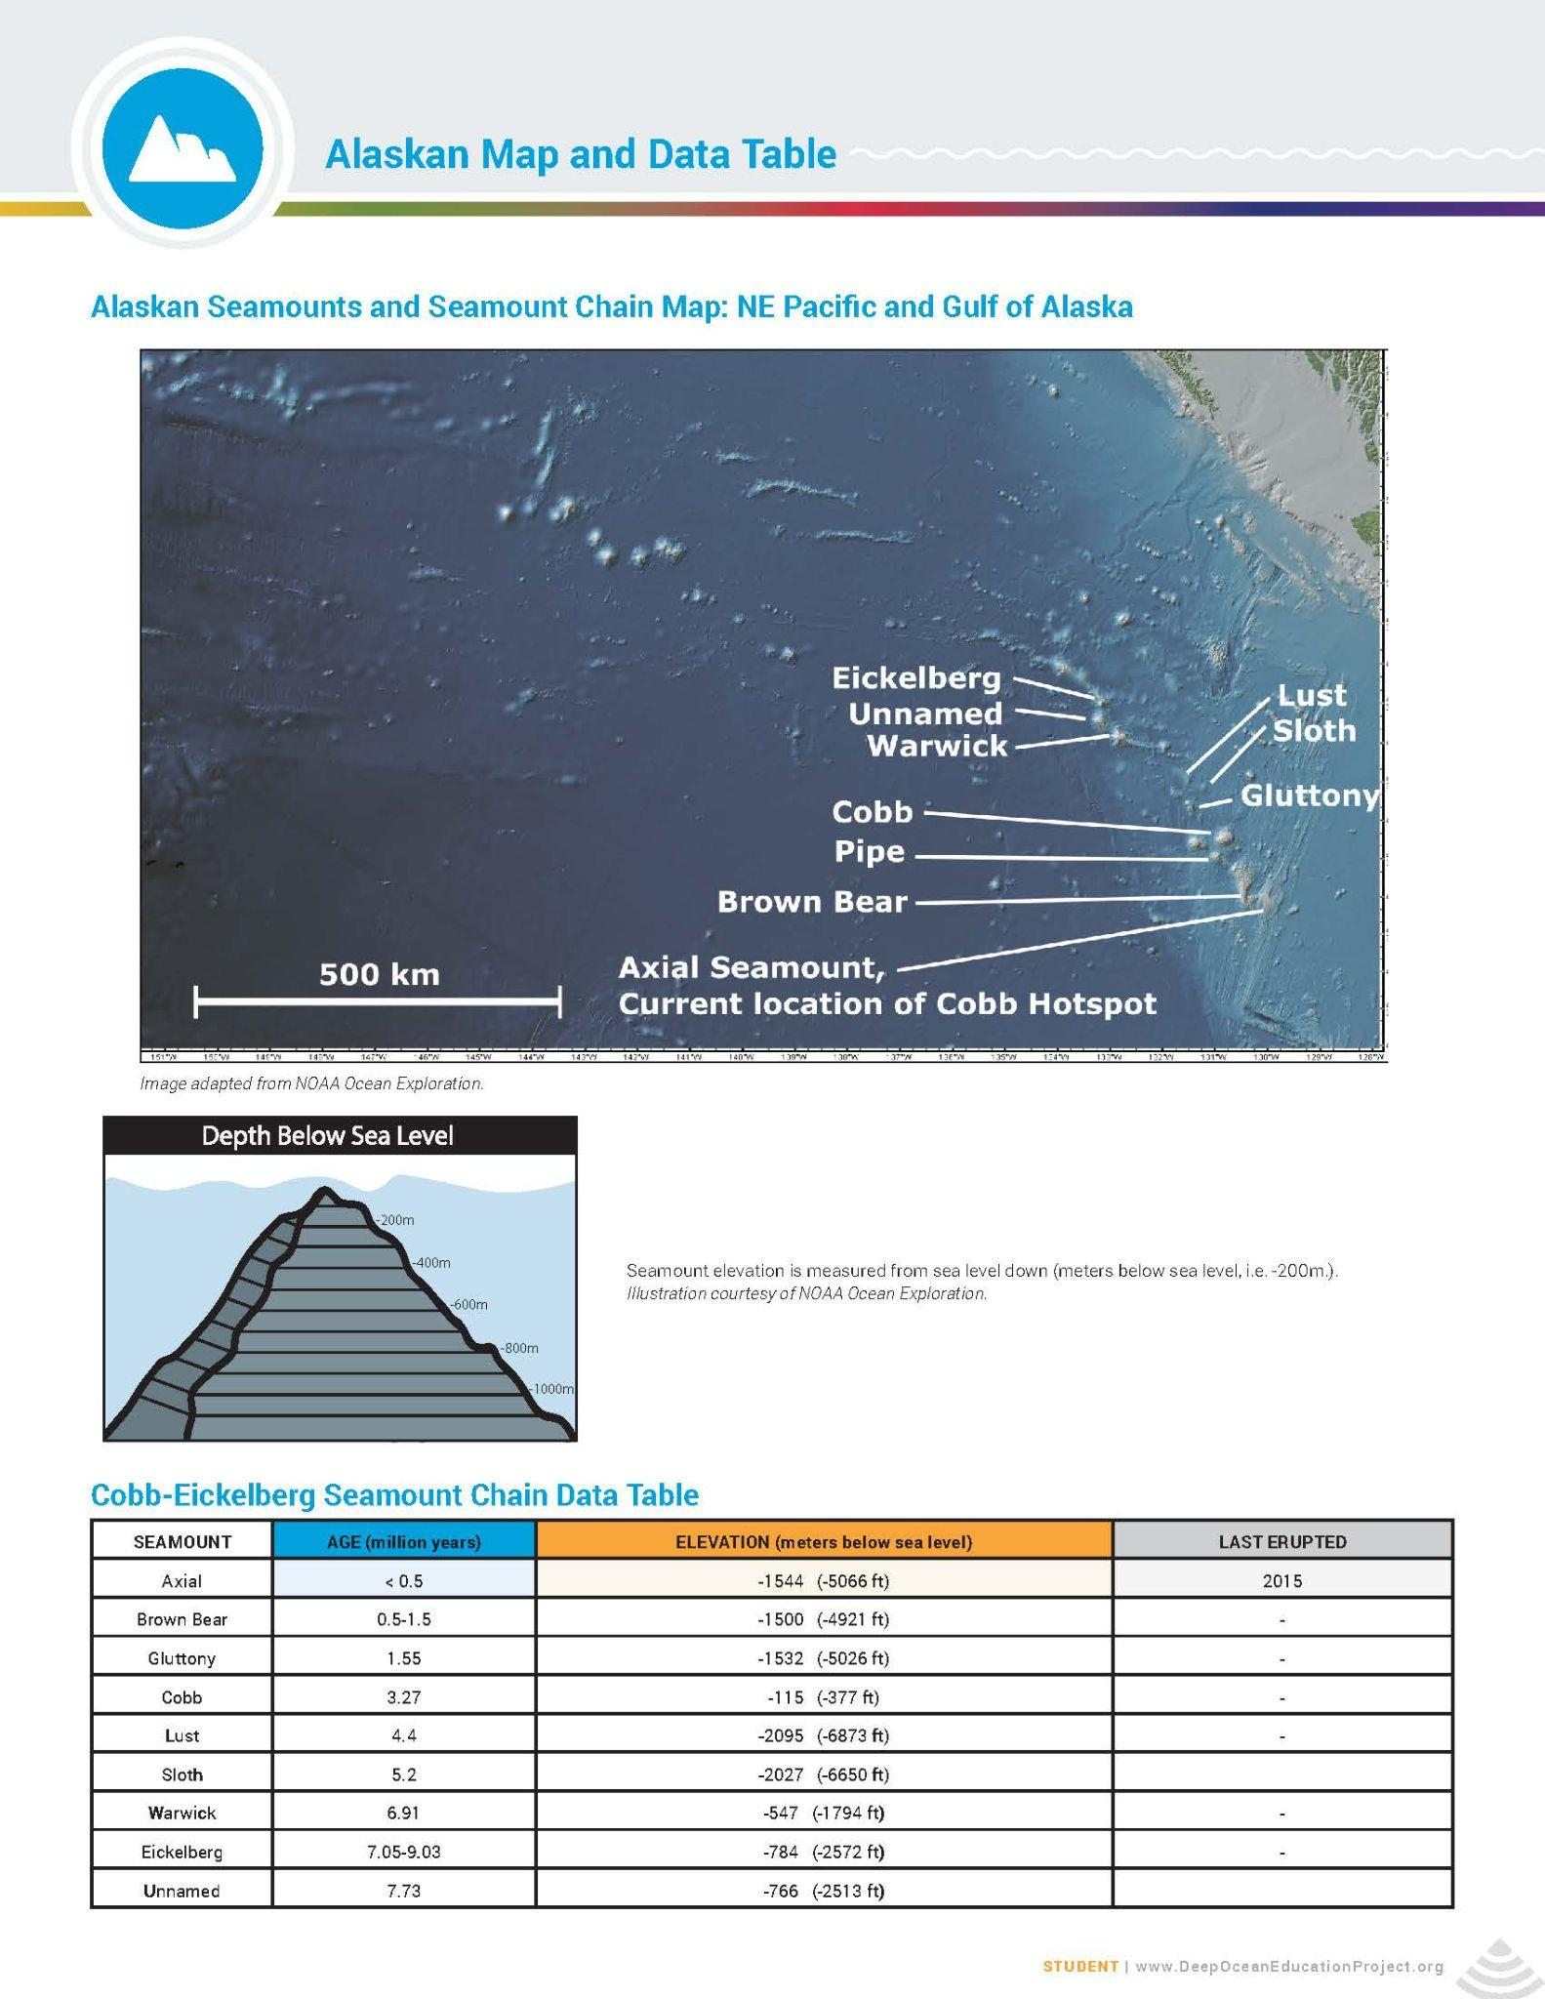
Experience the Phenomenon

Slide 3
Experience the Phenomenon
Notice - Observations | Wonder - Questions

Slide 4
Guiding Questions
What patterns do you observe in the data presented in the maps and tables?
How does the data change over time?
What questions could you ask to help explain the patterns in the data you observed?

Slide 5
DRIVING QUESTION:
How do seamounts and island chains form in the middle of the ocean?

Slide 6


Investigate: Shaving Cream Seamounts Demonstration
Tectonic Plate
Magma from hotspot

Slide 7
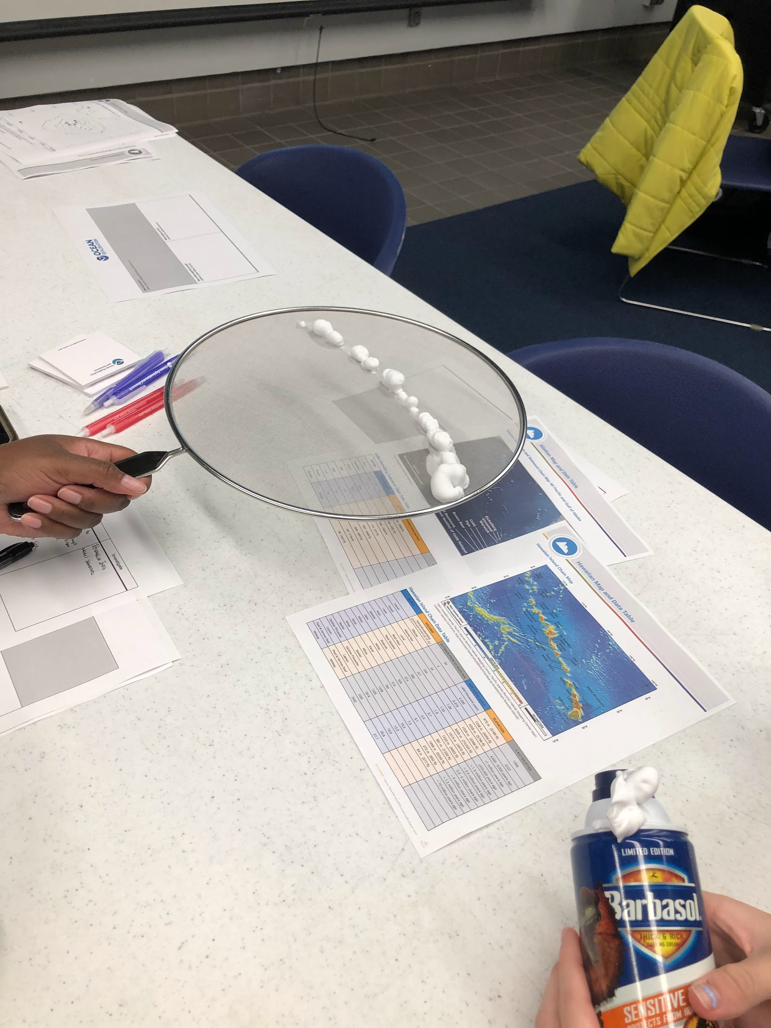
Investigate: Example for Teacher Reference
Seamounts/Seamount Chain
Tectonic Plate
Magma from hotspot

Slide 8
Shaving Cream Seamount Graphic Organizer
3) MECHANISM
Describe the process that connects the cause & effect.
1) EFFECT
Describe the phenomenon.
2) CAUSE
Describe the cause.
Developed by Jeremy Peacock and Amy Peacock, http://bit.ly/CCCGOs

Slide 9
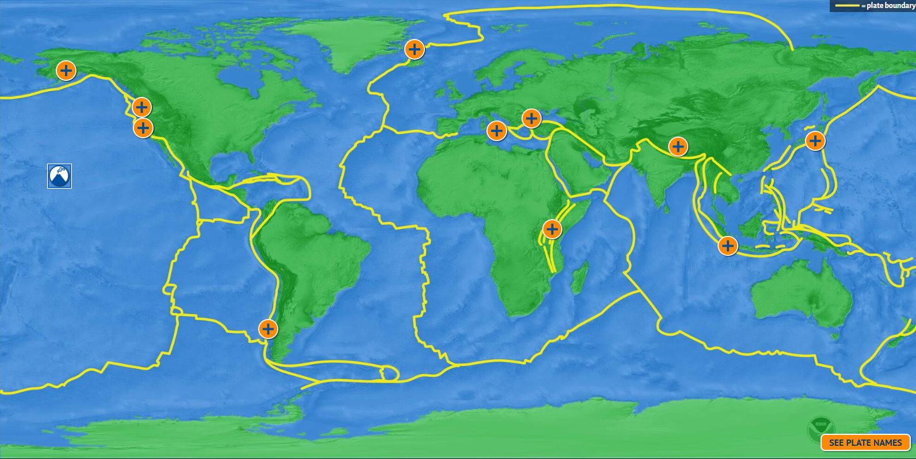
Investigate: Optional
Notes:
https://www.amnh.org/explore/ology/earth/plates-on-the-move2/game

Slide 10
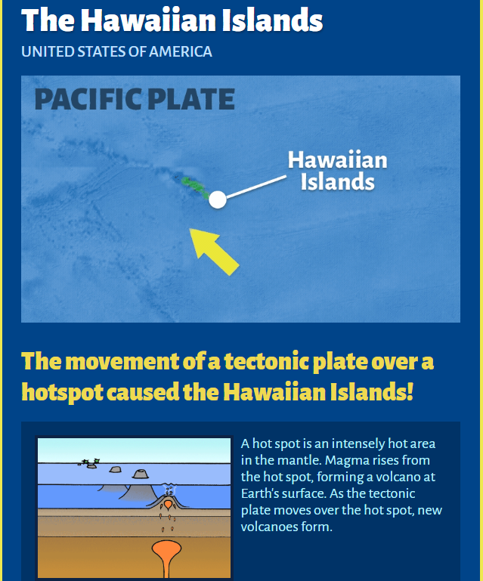
Investigate: Optional
Where did the magma come from that formed the hotspots?
What mechanism is “driving” the seafloor to move over the hotspot?

Slide 11
Put the Pieces Together
Seamount/Island Chain Model
Draw a model explaining how seamount chains form using everything you have learned.
Share and compare with your group and the class.

Slide 12
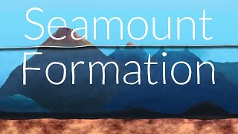
Seamounts: What are They?
Notes:
https://www.youtube.com/watch?v=OPlNQBNGUTA

Slide 13
Teacher Keys

Slide 14
Shaving Cream Seamount Graphic Organizer
3) MECHANISM
Describe the process that connects the cause & effect.
1) EFFECT
Describe the phenomenon.
2) CAUSE
Describe the cause.
A hot spot erupts through the overlying crust (tectonic plate). An underwater volcano forms an island or seamount as the magma solidifies and the plates move further from the hot spot. Successive eruptions form additional islands and seamounts.
A hot spot erupts through the overlying crust (tectonic plate).
Lines of islands and seamounts are formed in the middle of the ocean.
Developed by Jeremy Peacock and Amy Peacock, http://bit.ly/CCCGOs

Slide 15
Sample Seamount/Island Chain Model
Hotspot volcano erupts under water, lava hardens forming a seamount
Repeated eruptions grow the seamount until it becomes an island
Over MANY years, the hotspot continues to erupt as the plate moves, forming an island chain. The oldest island is furthest from the hotspot.
Island
Ocean
Seamount
Hotspot
Moving plate
Crust
Hotspot
Hotspot
Mantle
Hotspot
Island
Island Chain

