Slide 1
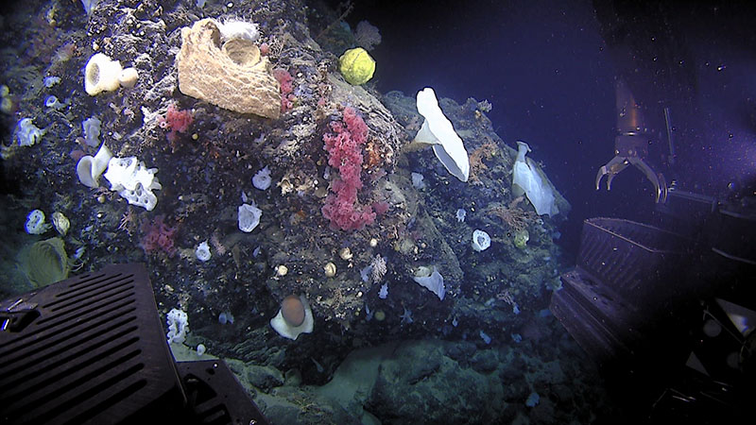
Habitat Complexity in the Deep Sea

Slide 2
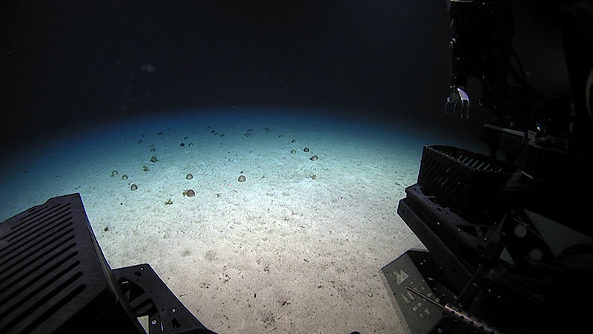
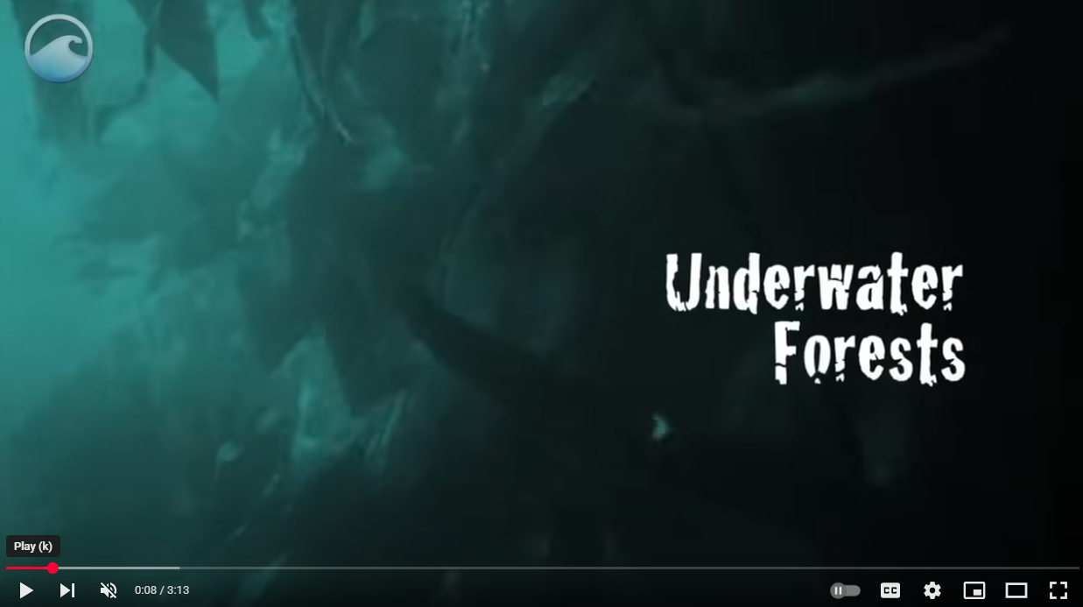
Introduction: Sandy Seafloor and Kelp Forest
Voyage to the Ridge, 2022 (Dive 8)
NOAA Ocean Exploration
Video (play without audio)
Image
Underwater Forests
NOAA National Ocean Service
Video (play without audio)
Image
Notes:
Soft Bottom:
Video: https://oceanexplorer.noaa.gov/okeanos/explorations/22voyage-to-the-ridge/features/urchins/urchins.html
Image: https://oceanexplorer.noaa.gov/multimedia/okeanos-explorations-22voyage-to-the-ridge-features-urchins-media-aggregation/
Kelp forest:
Video: https://www.youtube.com/watch?v=GcbU4bfkDA4
Image: https://sanctuarywatch.ioos.us/webcr-olympiccoast/kelp-forest

Slide 3
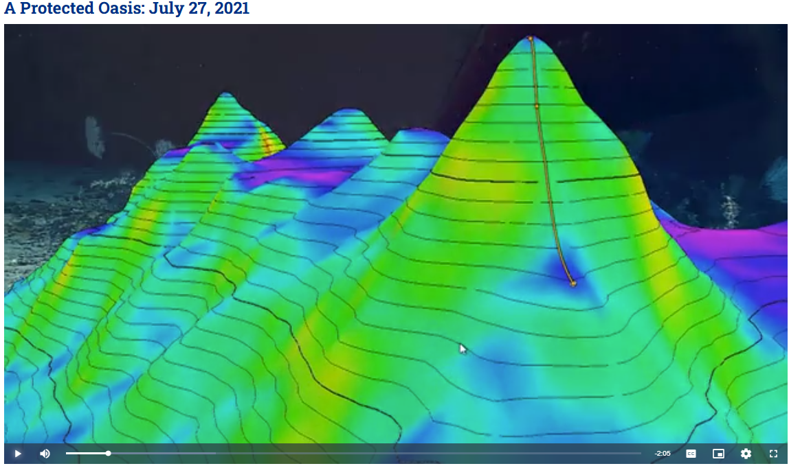
Learning Procedure : A Protected Oasis
https://oceanexplorer.noaa.gov/multimedia/video-playlist-ex2104-oasis/
Notes:
https://oceanexplorer.noaa.gov/multimedia/video-playlist-ex2104-oasis/
Retriever Seamount
2021 North Atlantic Stepping Stones expedition
Dive 19

Slide 4
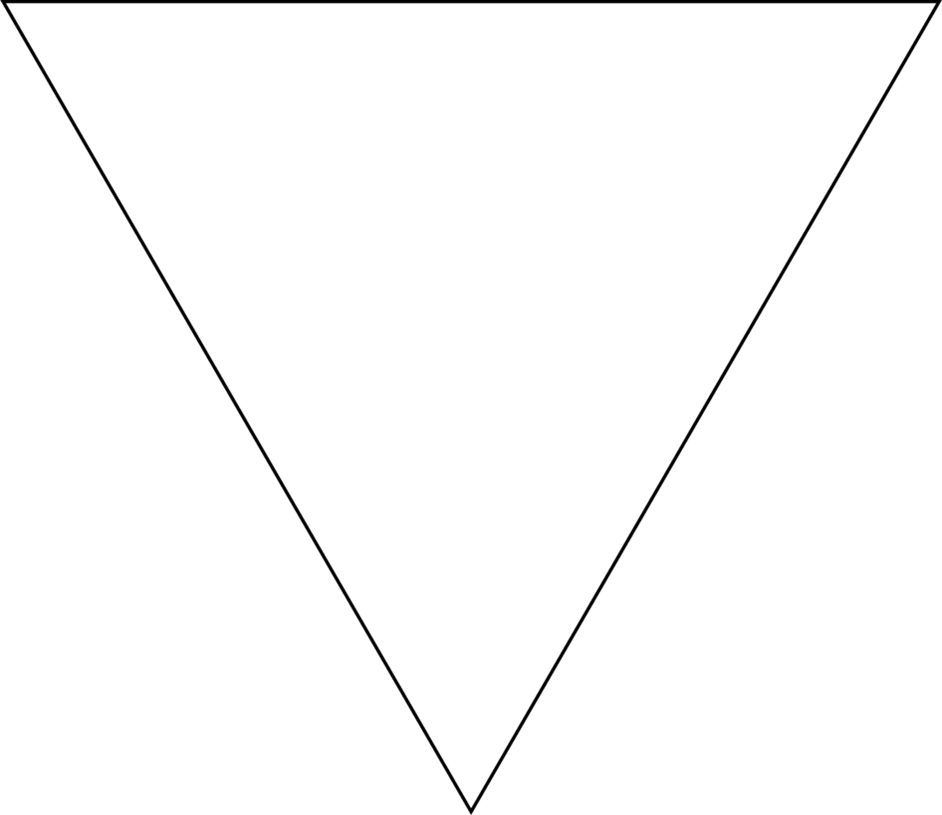

Driving Question:
How can we model the physical and biological complexity of deep-sea ecosystems (like seamounts, or any other habitat)?
Notes:
The triangle is intended to represent the most simplistic zoomed out version of an ecosystem - in this case, a seamount ecosystem.

Slide 5
KEY
Color | What this color represents
White
Gray
Red
Purple
___________
___________
___________
___________
Notes:
The triangle is intended to represent the most simplistic zoomed out version of an ecosystem- in this case, a seamount ecosystem.

Slide 6
KEY
Color | What this color represents
White | Seamount rock face
Gray
Red
Purple
___________
___________
___________
___________
Notes:
The triangle is intended to represent the most simplistic zoomed out version of an ecosystem- in this case, a seamount ecosystem.

Slide 7
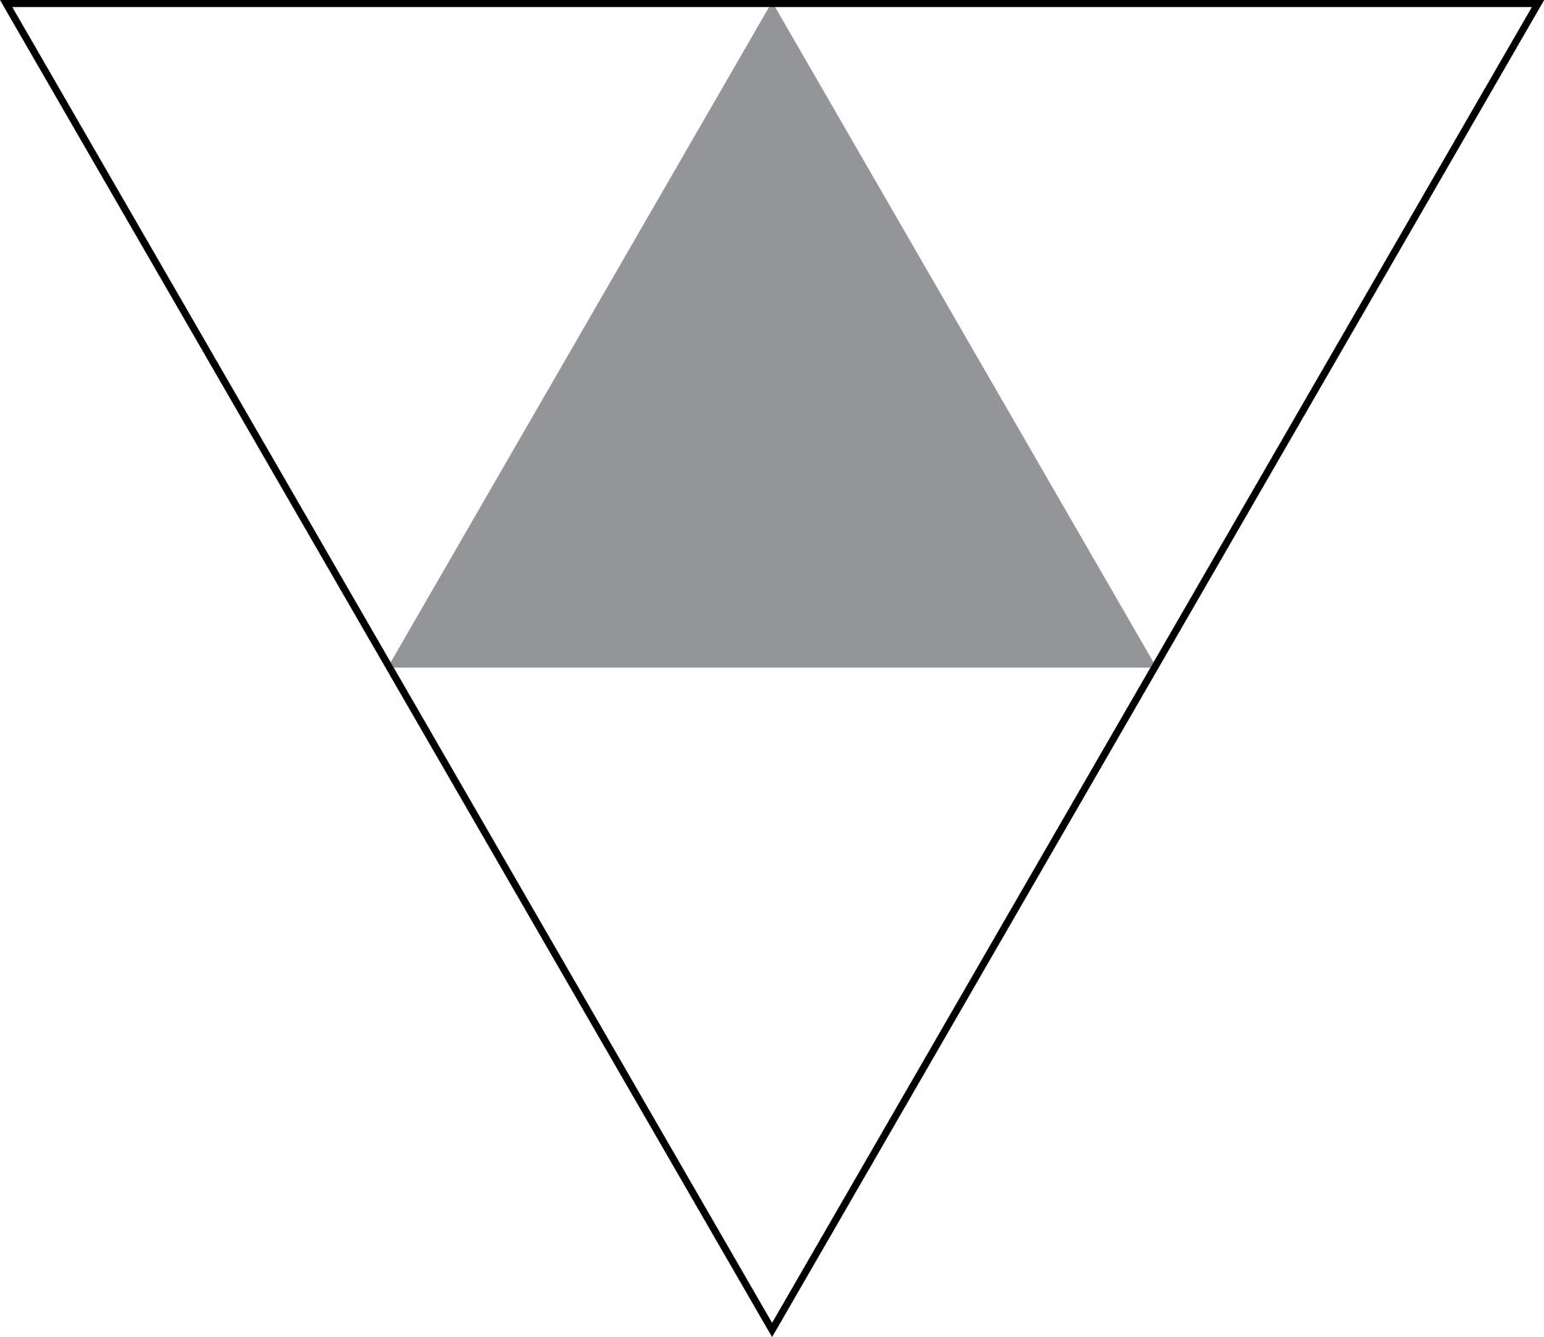
Step 1:
Find the midpoint of each side of your largest equilateral triangle.
Connect the midpoints on each side, forming a new triangle in the middle.
Color the new triangle in the middle of the larger triangle gray.

Slide 8
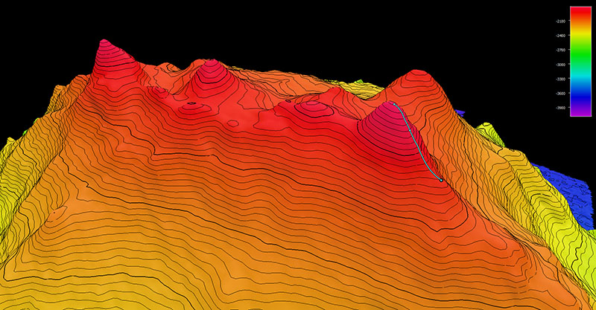
Watch the video:
Life Two Miles Down (00:00 - 00:30)
NOAA Ocean Exploration
Thinking back to the video, what might the shaded triangle represent?
Notes:
Show the video below (at least 0 - :30) and/or the images on slide 10:
Life Two Miles Down: https://oceanexplorer.noaa.gov/multimedia/okeanos-explorations-ex2104-dives-dive15-media-dive15-milesdown/
Seamount rock formations - excellent substrate for organisms to attach to.

Slide 9
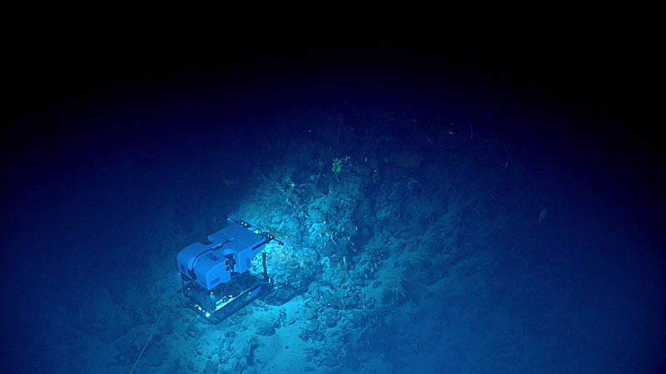
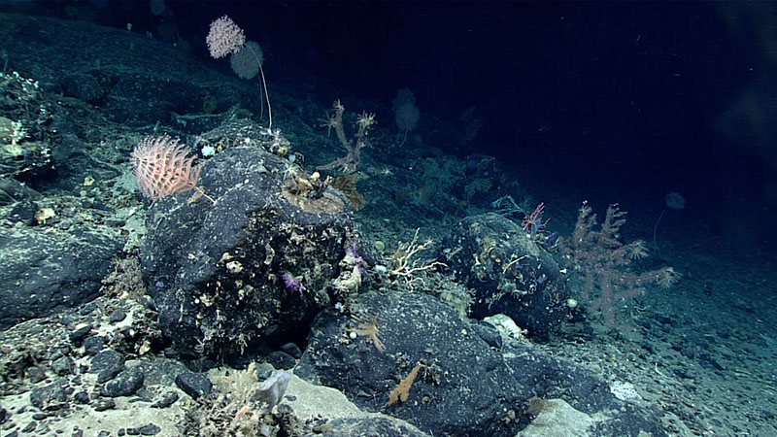
Helpful Hints
Below are some still images from Retriever Seamount, the featured seamount in the video.
What do you think the gray, shaded triangle represents as the next level of complexity in the seamount ecosystem?
All images courtesy of NOAA Ocean Exploration
Notes:
Thinking back to the video and looking at these images, what do you think the next level of complexity would be?
Seamount rock formations (rocks and boulders) - excellent substrate for organisms to attach to.

Slide 10
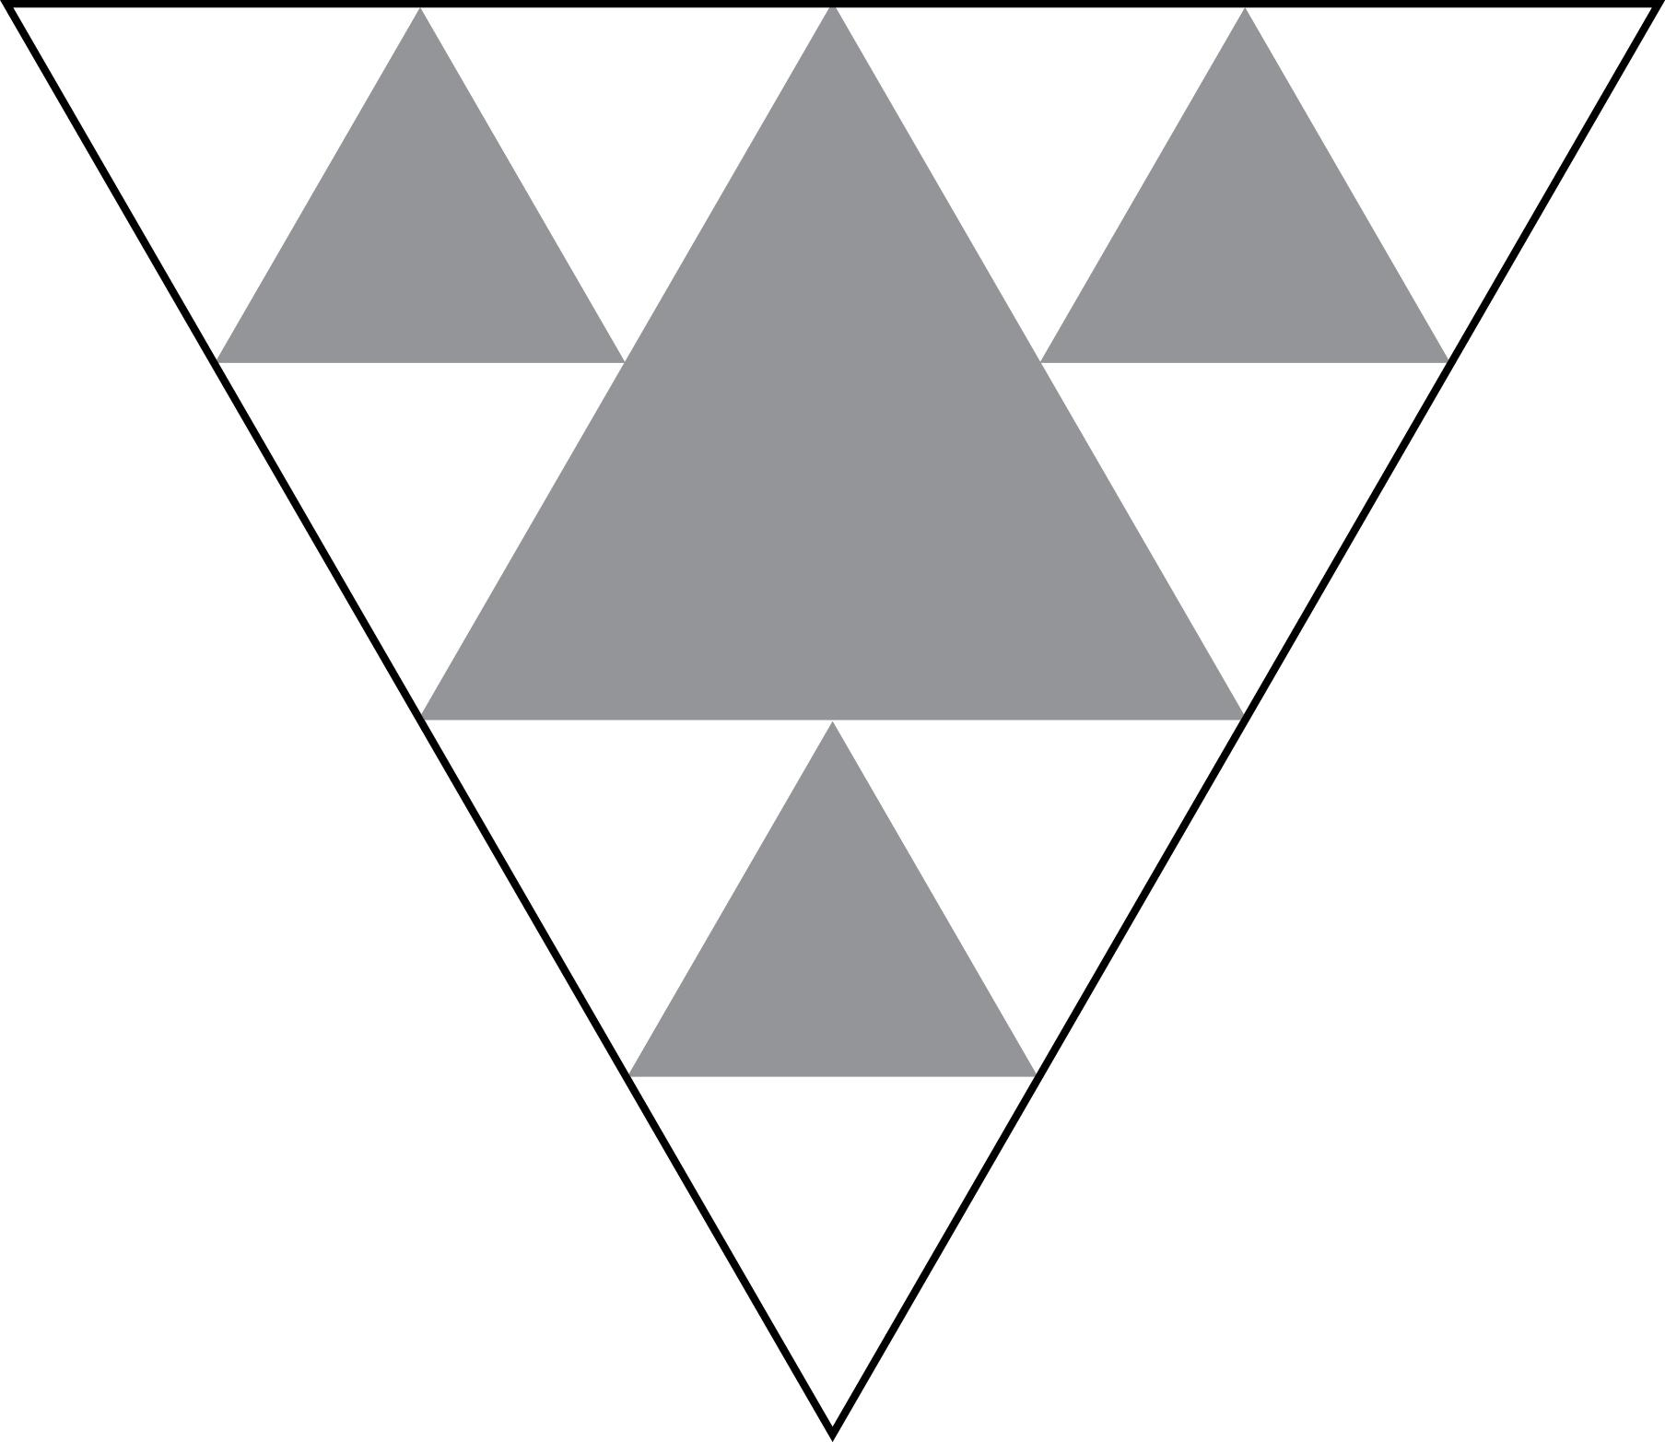
Step 1 continued…:
Consider you are looking down at a small portion of the surface of a seamount.
Repeat the measurement process in each of the three white triangles.
Color your three new triangles the same gray.

Slide 11
Step 1 continued…:
Again, thinking back to the video, what might these additional gray triangles represent?
Label these on your worksheet.
Notes:
Nooks and crannies within the rocks, providing substrate and hiding places.

Slide 12
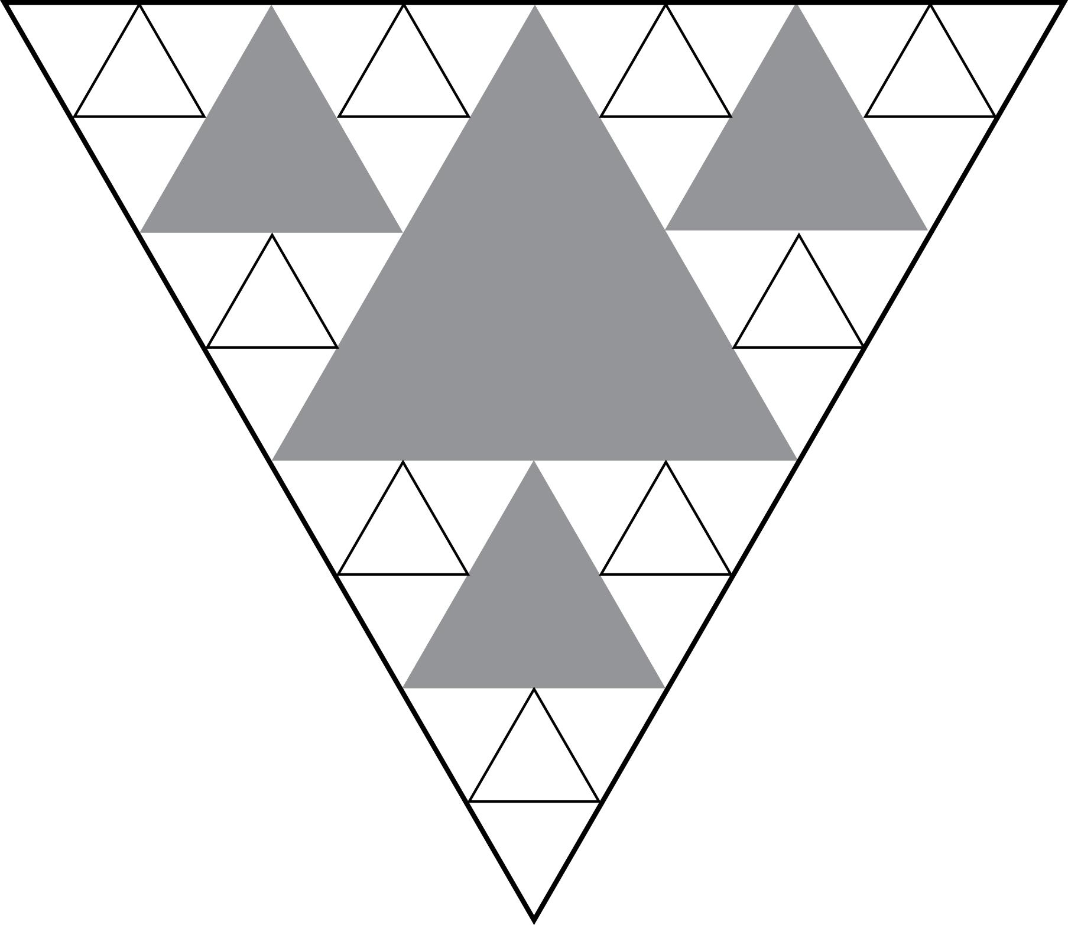
Step 2:
Repeat the division process in the next layer of 9 white triangles.

Slide 13
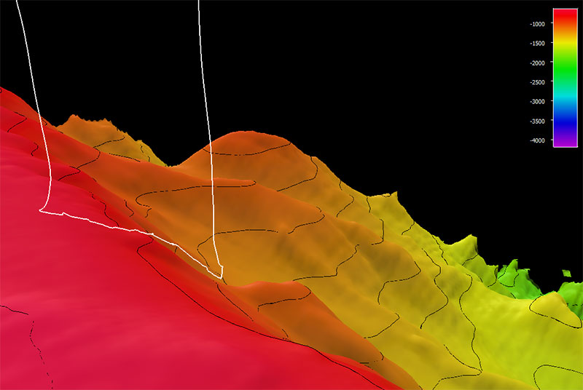
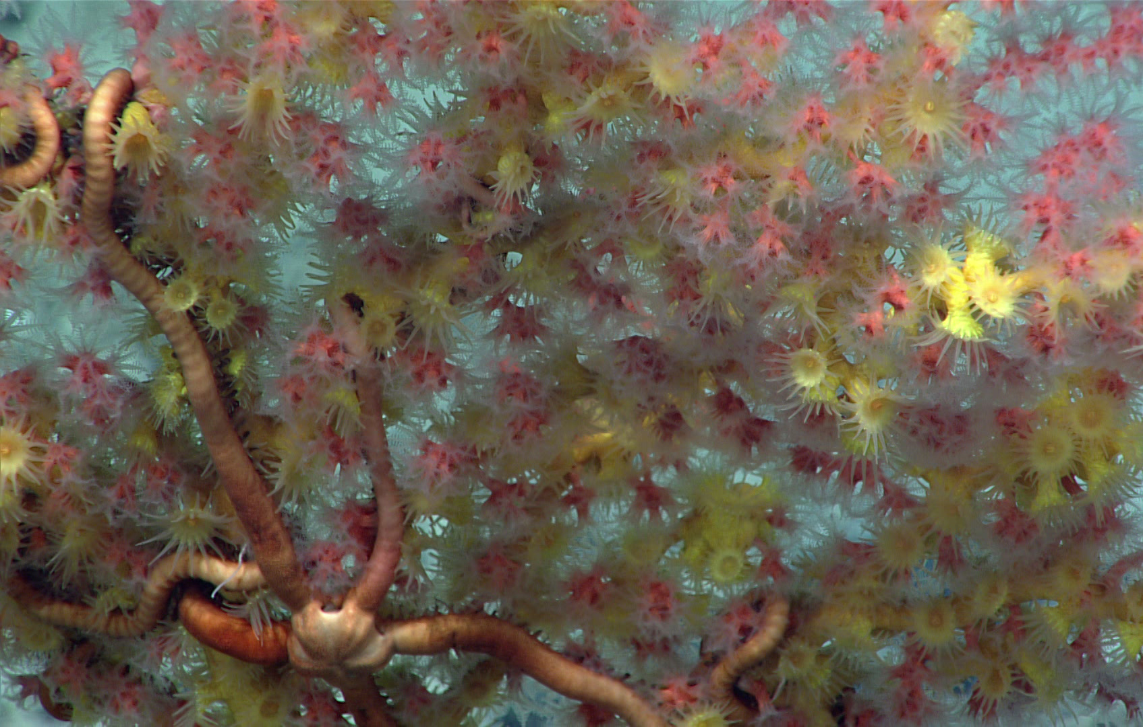
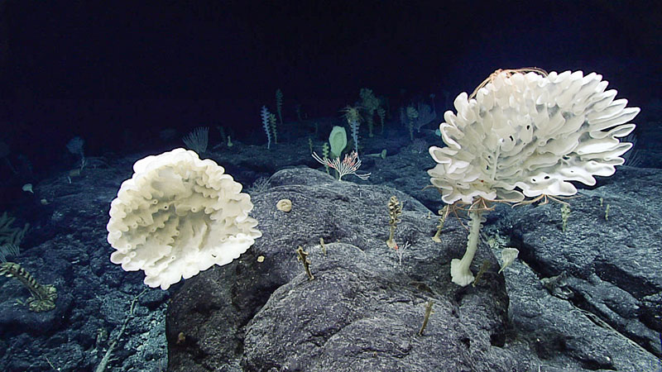
Watch these four short videos:
Giacomini Seamount (1:21)
NOAA Ocean Exploration
A Coral Garden (1:23)
NOAA Ocean Exploration
Forest of the Weird (1:42)
NOAA Ocean Exploration
Sponge-A-Palooza (1:14)
NOAA Ocean Exploration
What might these nine triangles represent in a seamount habitat?
Notes:
Deep-sea corals and/or sponges.

Slide 14
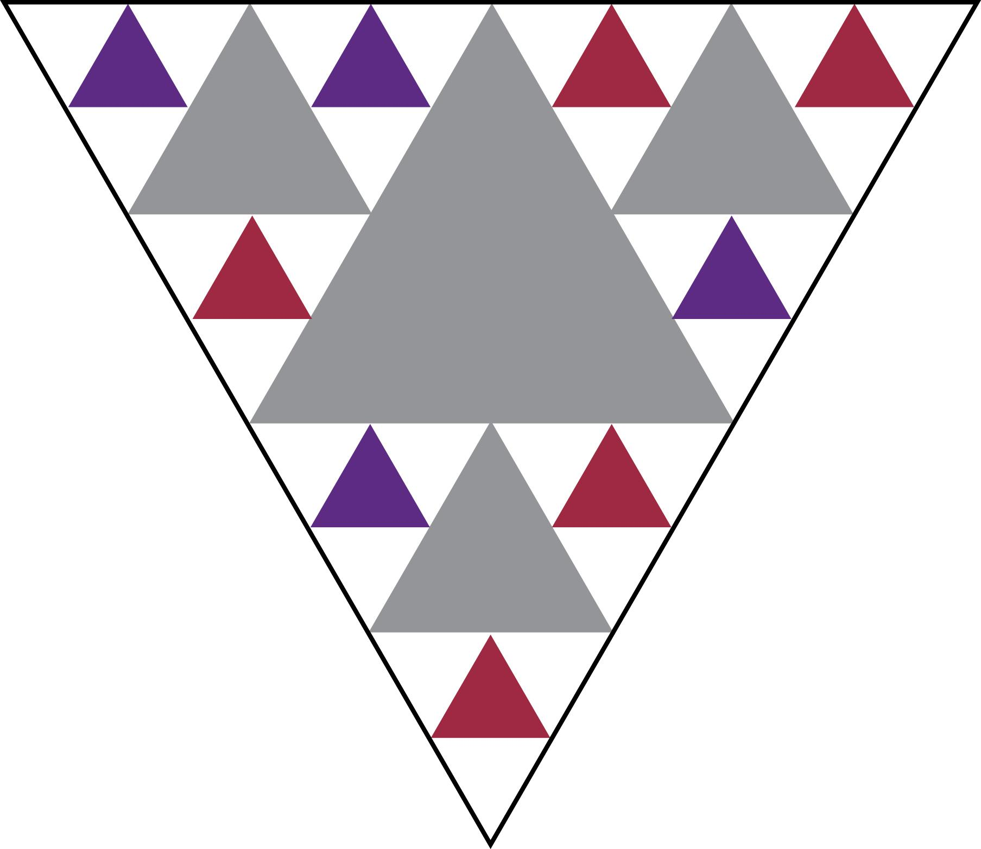
Step 2 continued…:
Decide on the abundance of corals and sponges living on your seamount.
Color your corals red and your sponges purple.
Label them in your key.
Notes:
In this sample, red represents corals and purple represents sponges.
Students will have any ratio of each.

Slide 15
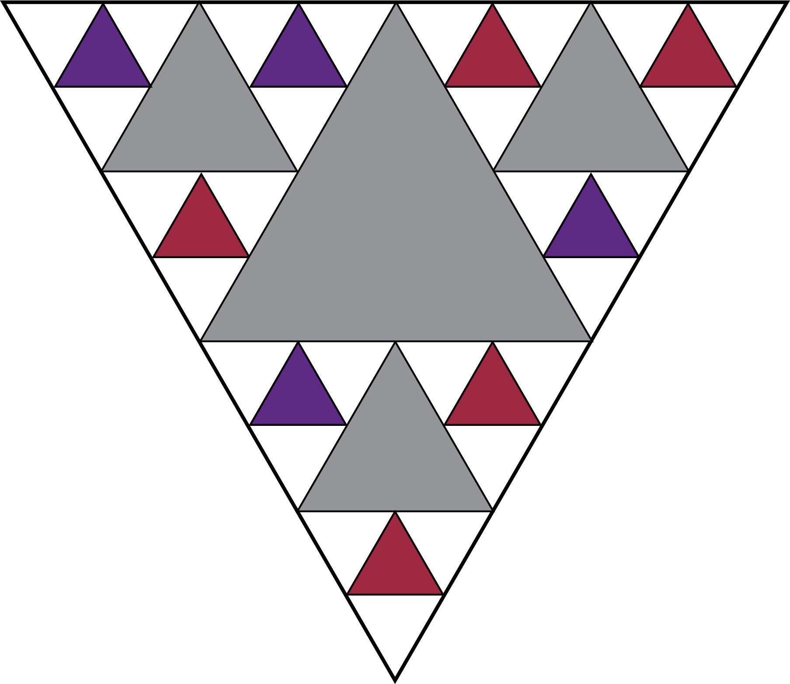
Step 3:
Continue the division of the triangles again for the 27 new triangles you just created.

Slide 16
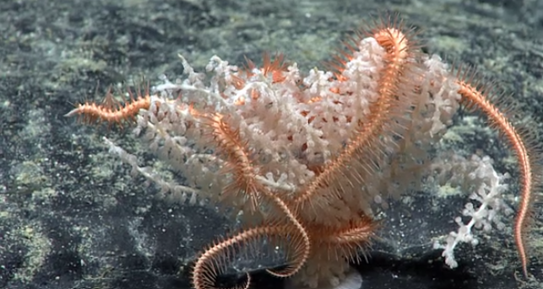
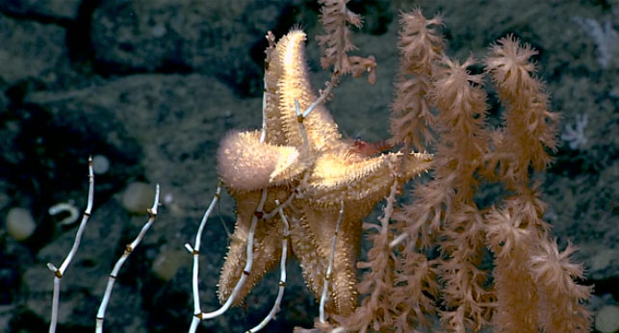
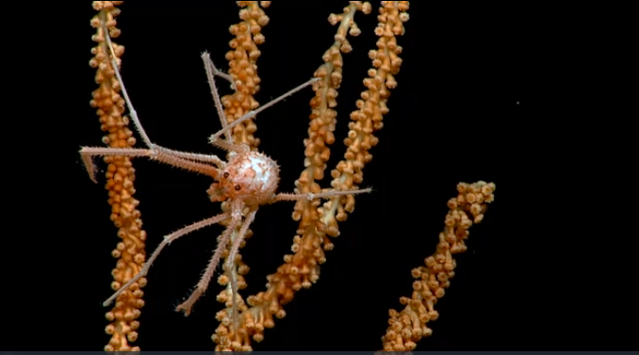
Watch these two short videos:
From a Coral Polyp an Island Grows (1:10) NOAA Ocean Exploration
Giacomini Seamount(1:21)
NOAA Ocean Exploration
What might these triangles represent in a seamount habitat?
Notes:
Species could include brittle stars, basket stars, anemones, urchins, feather stars, sea
spiders, fishes, etc. Encourage students to create their community of choice!

Slide 17
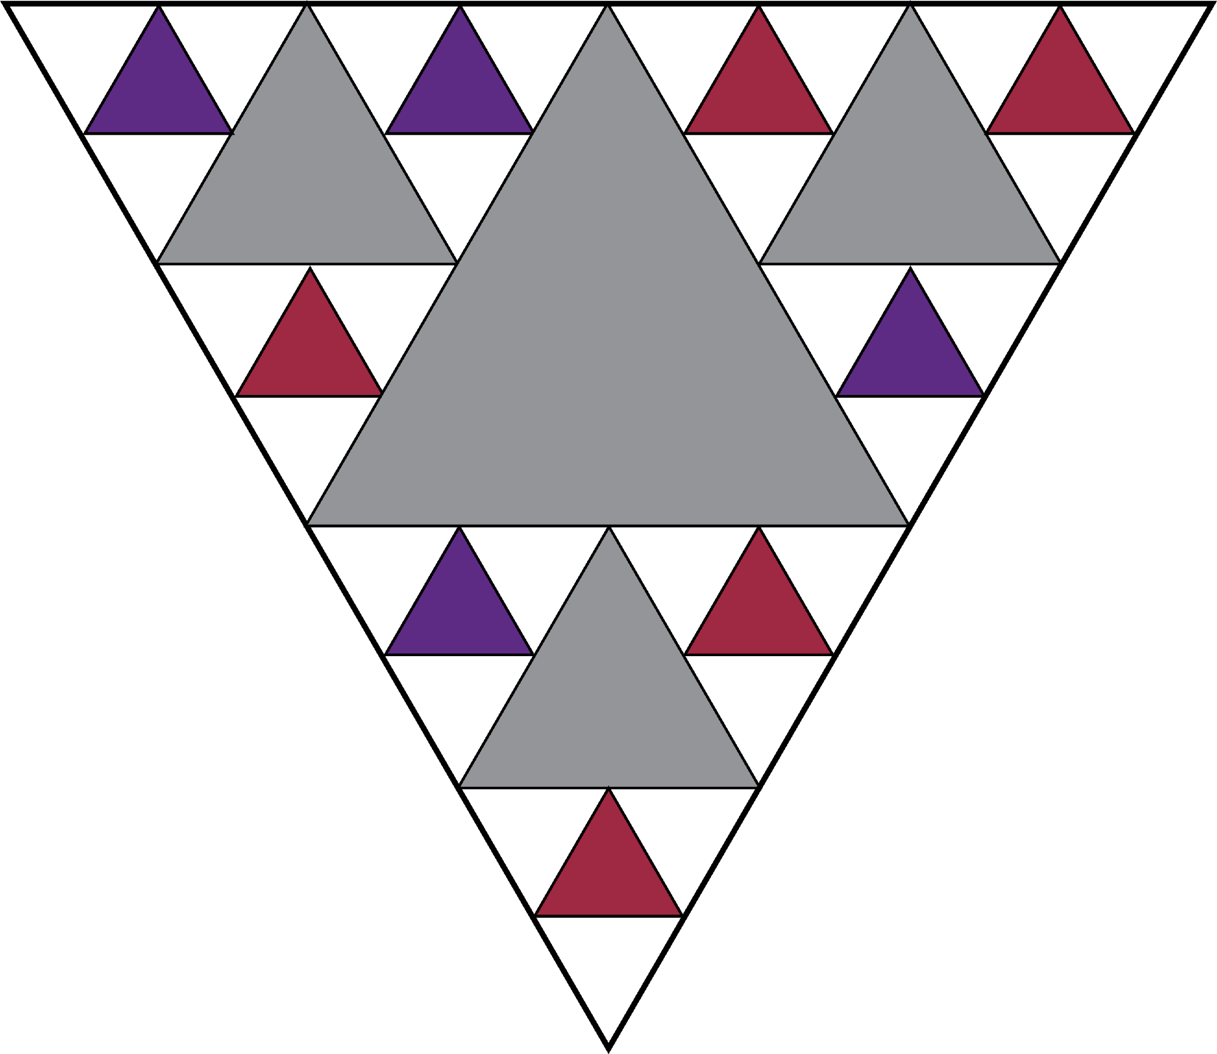

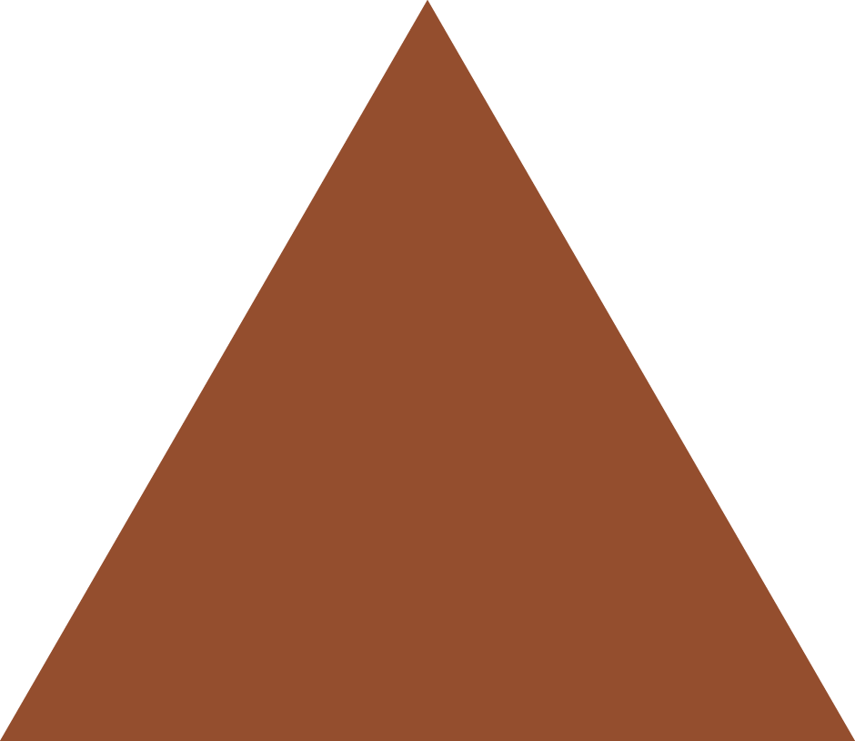



Step 3 continued…:
This time… based on the videos you’ve seen, decide what additional organisms live on your seamount and how many of each.
Color each species a different color.
Label what they represent in your key.
Notes:
Species could include brittle stars, basket stars, anemones, urchins, feather stars, sea
spiders, fishes, etc. Encourage students to create their community of choice!

Slide 18
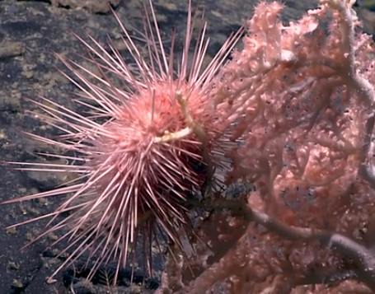
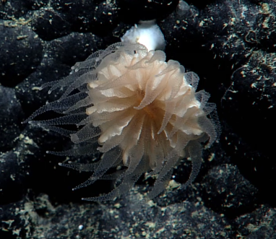
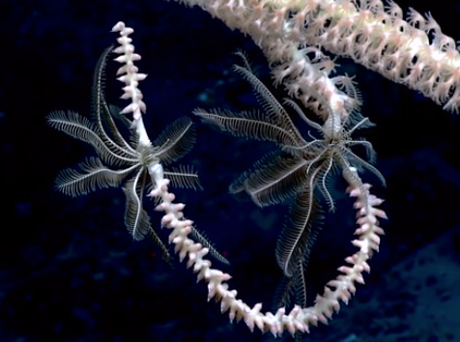
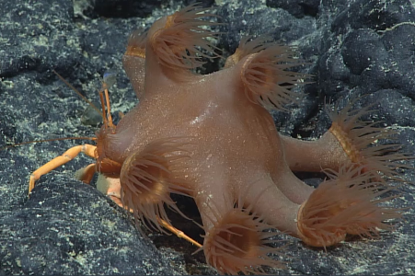
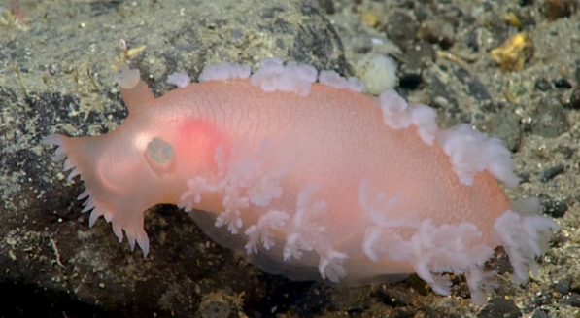
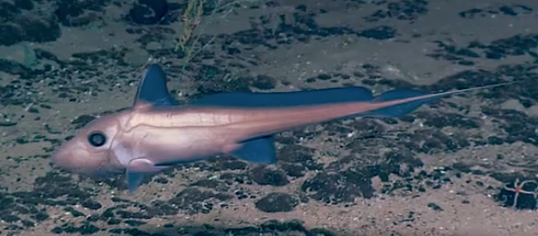
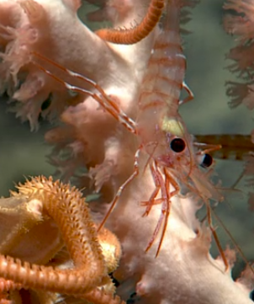
Deep-sea Coral and Sponge Communities:
Sample inhabitants
Brisingid sea star
Sea star
Squat lobster
Sea urchin
Sea anemone
Ratfish
Sea cucumber
Feather stars
Hermit crab with
anemone “hat”
Shrimp

Slide 19
KEY (completed sample)
Color | What this color represents
White | Seamount rock face
Gray | Rocks/boulders; nooks/crannies
Red | Deep-sea corals
Purple | Deep-sea sponges
Light blue | Brittle stars
Orange | Feather stars
Brown | Squat lobsters
Dark blue | Anemones
Notes:
The variety of colored triangles can represent species could include brittle stars, basket stars, anemones, urchins, feather stars, sea
spiders, fishes, etc.
Encourage students to create their community of choice!

Slide 20
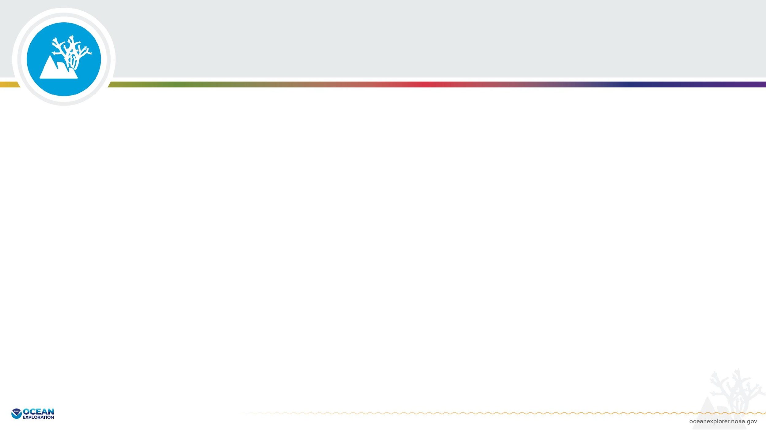
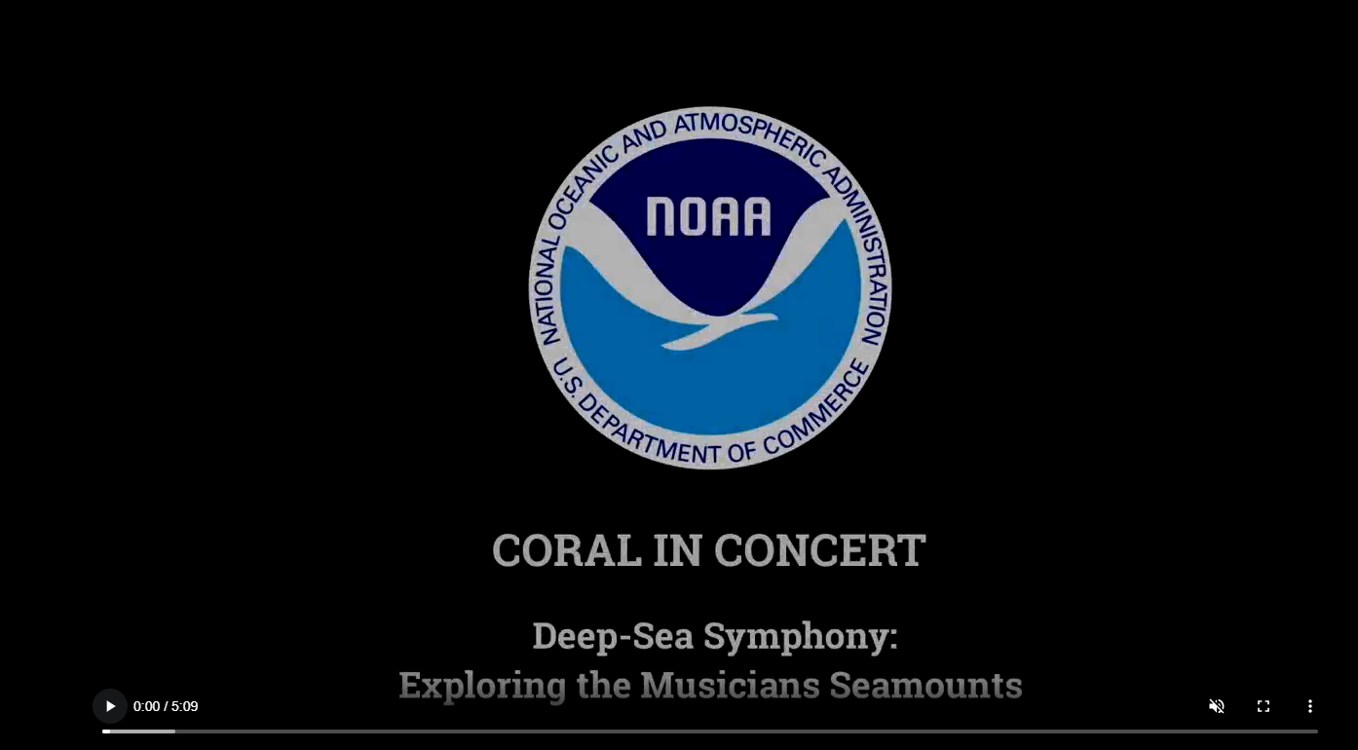
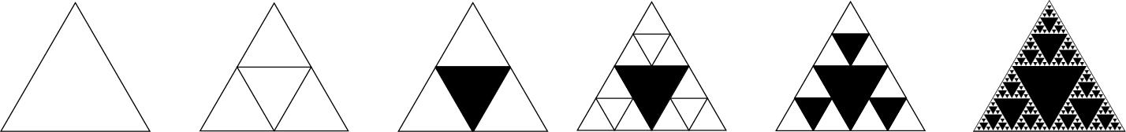
Could you keep going with more triangles?
Watch this video
Coral in Concert (5:09)
NOAA Ocean Exploration
What could even smaller triangles in your model represent?
How does this model mimic a real habitat?
Notes:
Show all or a portion of this video:
Coral in Concert, (5:09) NOAA Ocean Exploration
Optional shorter clips if time is limited:
2:01 - 2:28 - high density of corals
3:00 - 3:29 - Coral forest, coral and sponge aggregations, hotspots of biodiversity
3:29 - 3:50 - Hemicorallia, 200 yrs old, 6 inches at base; crinoids (feather stars), brittle stars, etc living on it
4:27 - 4:42 - High density communities of corals and sponges.

Slide 21
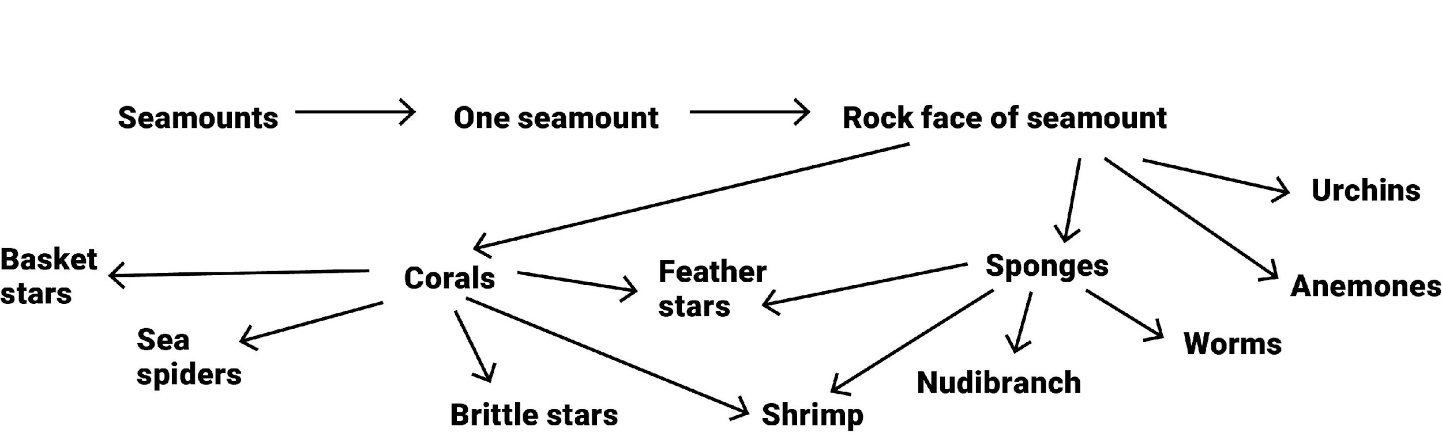
Put the Pieces Together
Can you illustrate the increasing complexity of the habitat/community you built with a word diagram?
Example:

Slide 22
What did we learn/observe?
What did you learn about seamounts as habitat?
What did you learn about deep-sea corals and sponges?
What did you learn about available space in a habitat/habitat complexity?
What would likely happen if the corals and/or the sponges were removed from this habitat?
What are the limitations of this model?
Notes:
What did you learn about seamounts as habitat?
Seamount rock formations themselves provide hard substrate/habitat for a
variety of species. They also provide many nooks and crannies (rugosity) for a variety of species to inhabit.
What did you learn about deep-sea corals and sponges?
Deep-sea corals and sponges provide hard substrate and also create intricate habitat (rugosity) for a wide variety of species.
What did you learn about available space in a habitat/habitat complexity?
Repeatedly dividing a fixed space produces an infinite series of increasingly smaller spaces that in nature are potential habitats for a wide variety of organisms. The number of species, and possibly species diversity, often correlates with the physical complexity of the habitat and the variety of resources in that habitat (food/shelter). Note: multiple variables impact species diversity.
What would likely happen if the corals and/or the sponges were removed from this habitat?
If the coral or the sponges were to be gone from this habitat, many of the other organisms would have nowhere to live and would no longer be there. Deep-sea corals and sponges are foundation species, providing shelter, and sometimes food and nursery grounds for many other species.
____
What are the limitations of the model?
It is not possible for us to repeat the process infinitely, so our model is only an
approximation.

Slide 23
Put the Pieces Together
Consider how the term Rugosity applies to a real seamount.
Rugose: wrinkled or ridged surface
Rugosity: refers to the quality or state of being wrinkled, rough, or having a wrinkled or
ridged surface

Slide 24
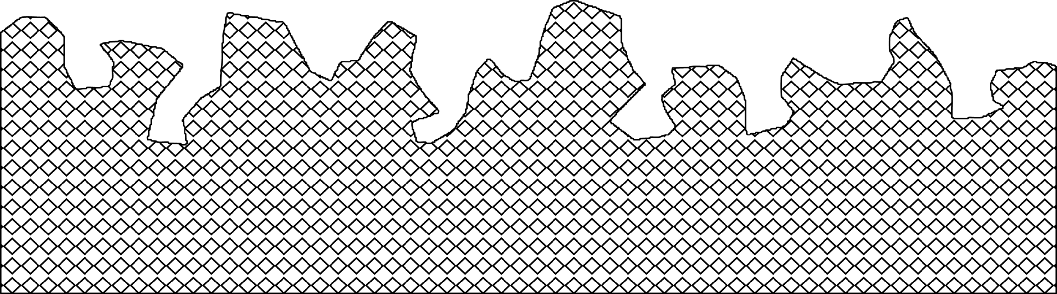
Seamount Substrate
Consider the habitat you just explored.
Using the “substrate” provided, draw a more realistic version of the elements/organisms in this habitat.
Label all items included.

Slide 25
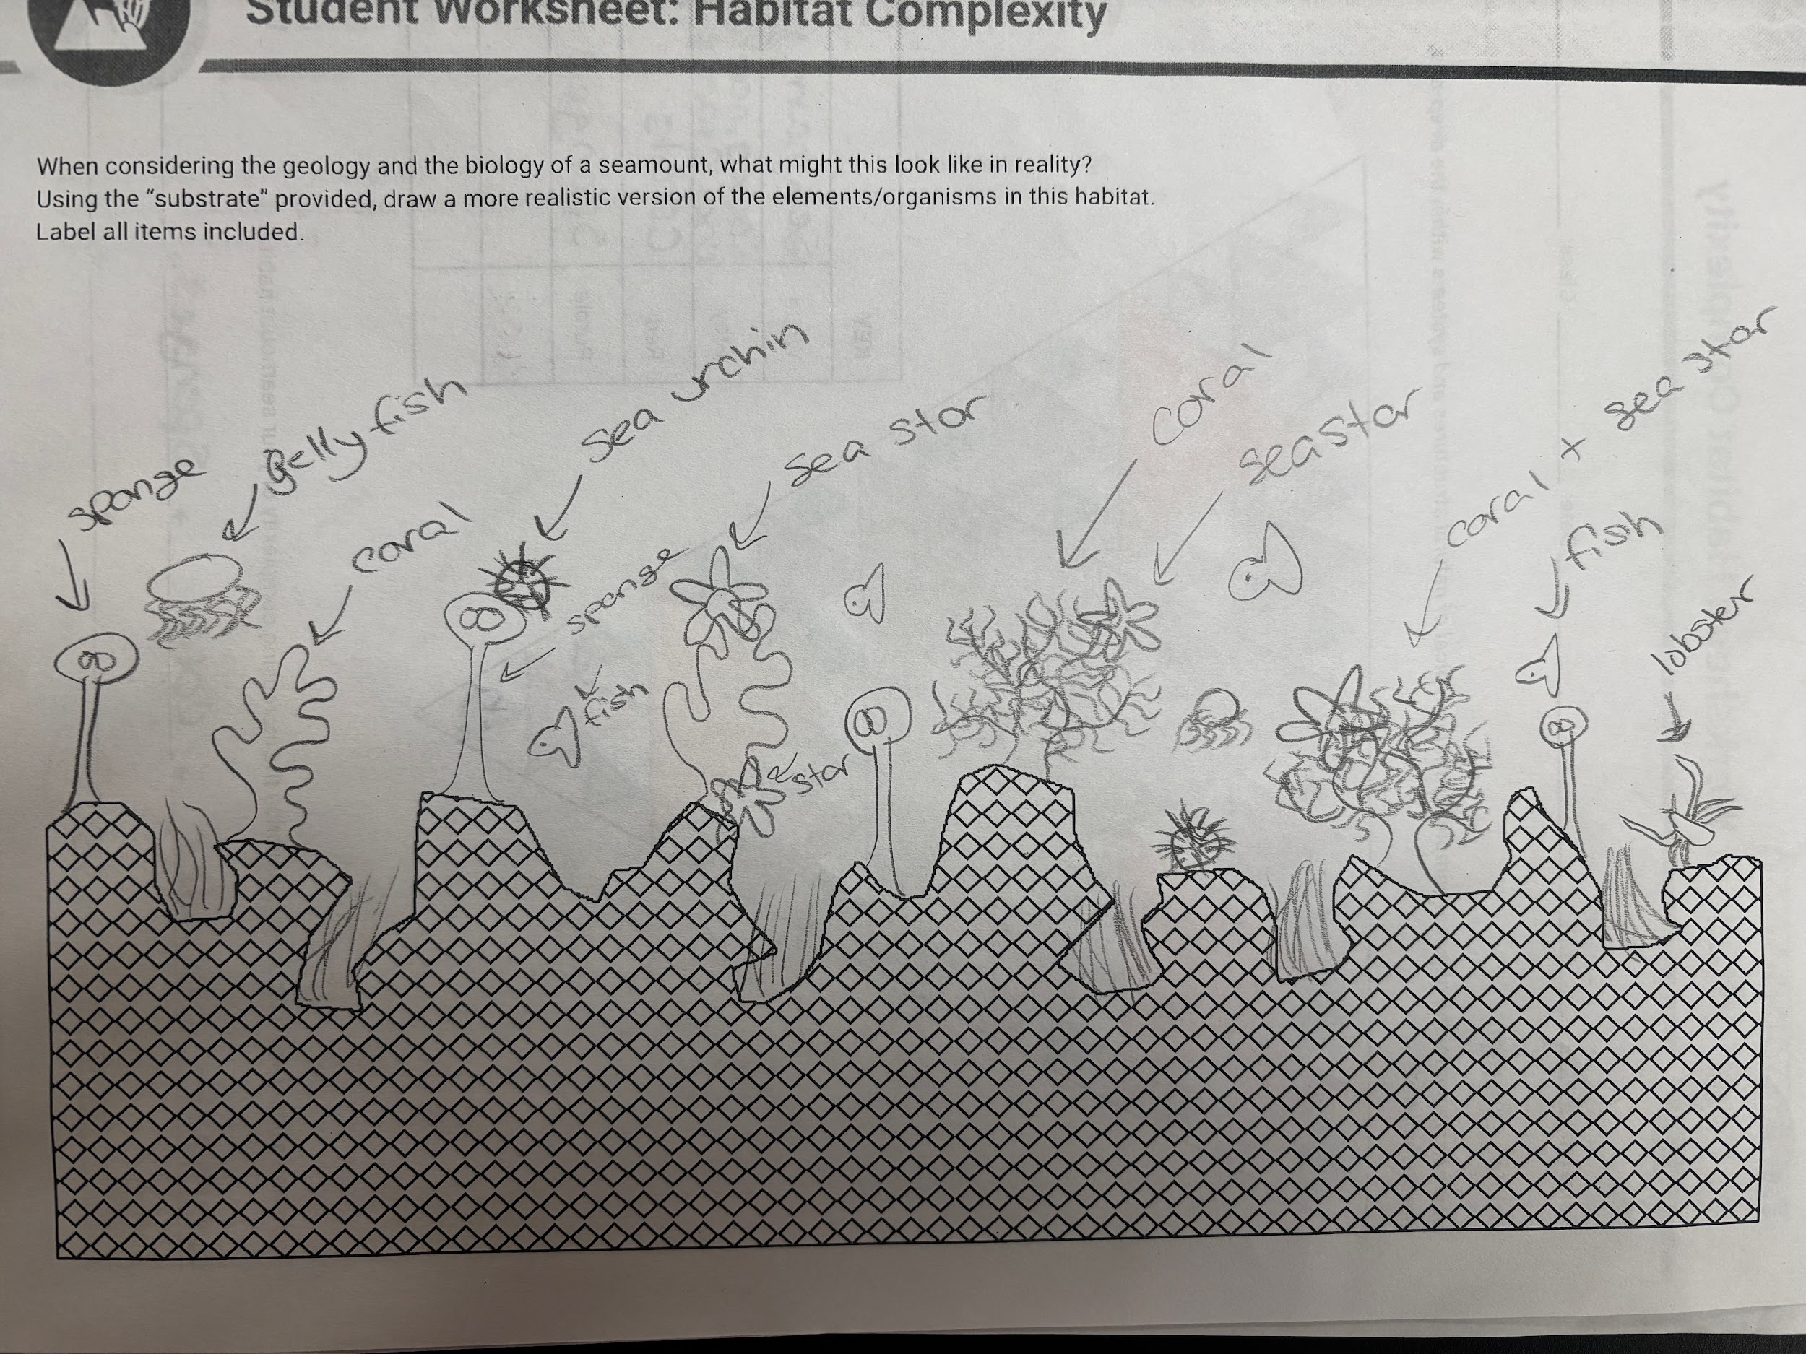
Seamount Substrate: Sample of Student Work

Slide 26
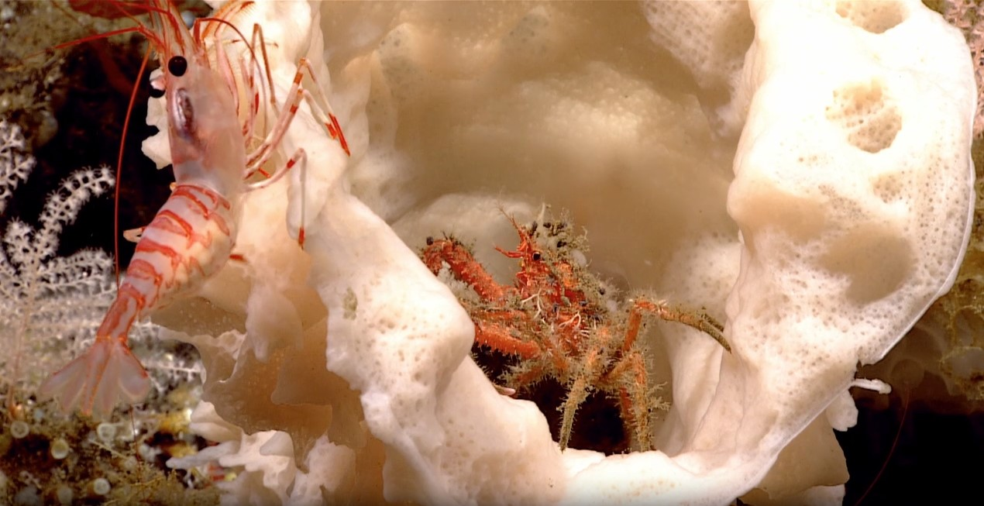
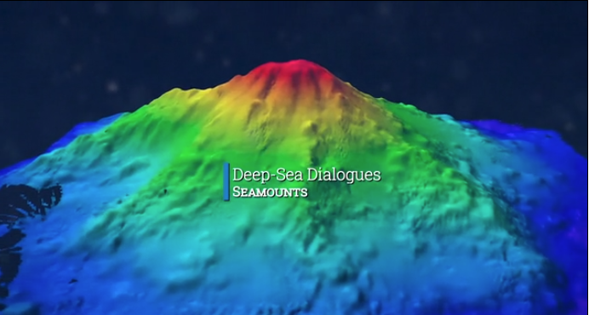
Optional Wrap-Up Videos
If you have not already, show the full Coral in Concert video.
Aleutians Bound, (4:36) NOAA Ocean Exploration
0 - 0:52 = corals, 0:53 - 2:03 = geology as substrate
Stunning Biodiversity in Palau’s Deep Sea, (7:21) Ocean Exploration Trust
1:56 - 2:57 = corals as ecosystem engineers
Deep-Sea Dialogues - Seamounts, (7:57) NOAA Ocean Exploration

Slide 27
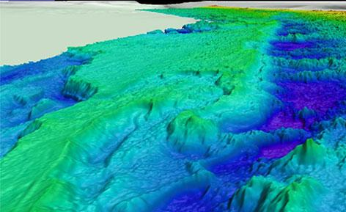
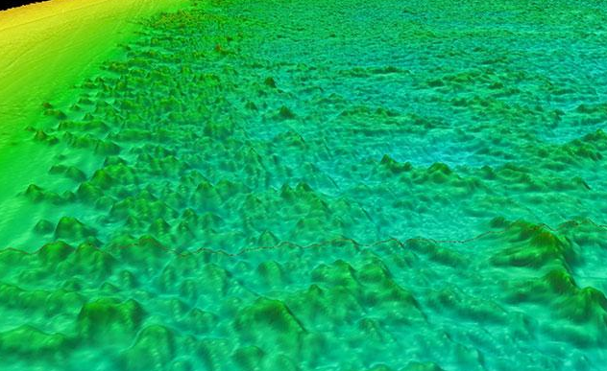
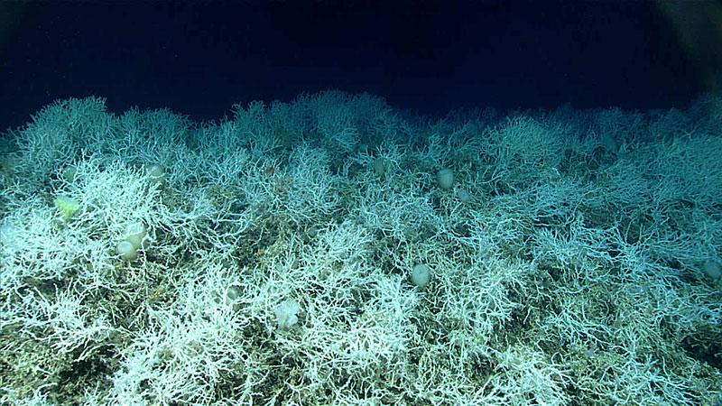
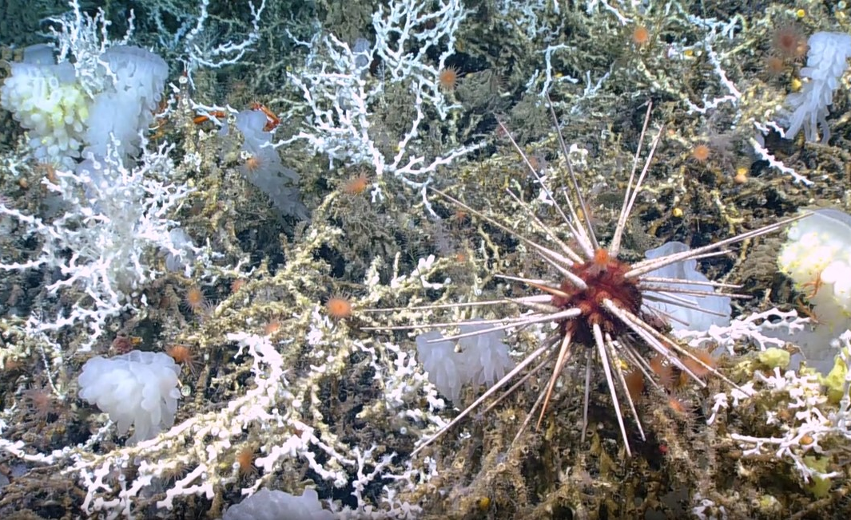
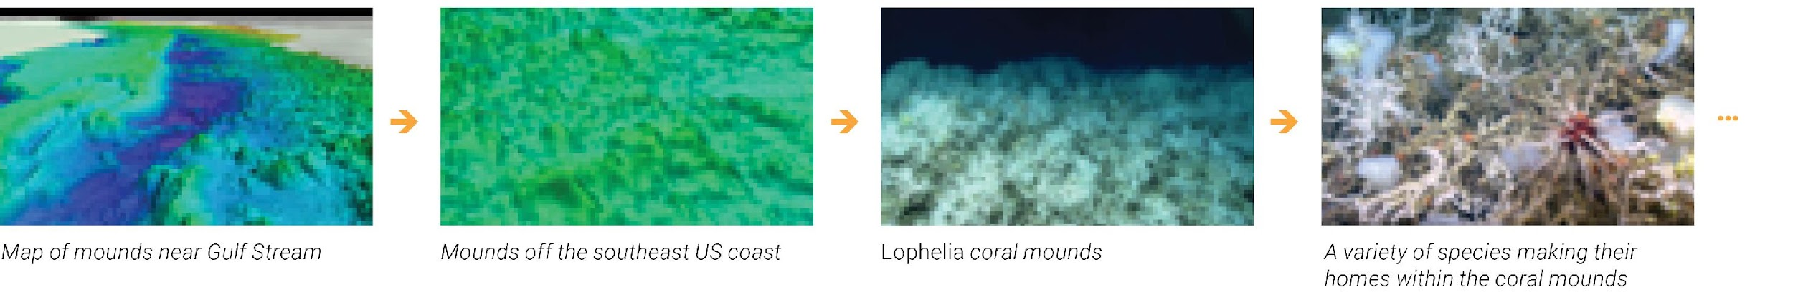
Extension: Million Mounds Coral Complex
Ancient Coral Gardens, (3:27) NOAA Ocean Exploration
Full video of habitat and organisms
Finding a Previous Undetected Coral Reef, (2:15) NOAA Ocean Exploration
…
Background information: Million Mounds coral complex

Slide 28
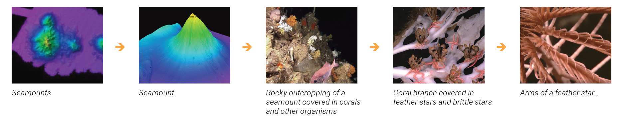
Extension: Seamounts
Can you illustrate the increasing complexity of the habitat you built with a word diagram?
Example of complexity at different scales as we zoom in on a habitat:
Seamounts → Seamount → Rocky outcropping of a seamount covered in corals and other organisms → Coral branch covered in feather stars and brittle stars → Arms of a feather star…
…
Image source: https://archive.oceanexplorer.noaa.gov/okeanos/explorations/10index/logs/photolog/photolog.html#

Slide 29



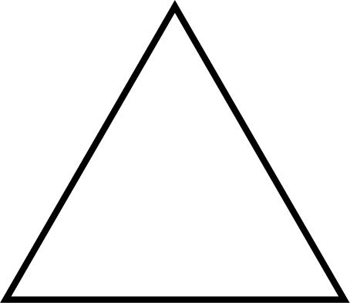
Triangle Templates
1
1
3
9 (total)
27

Slide 30
Triangle Templates

Slide 31
Optional Extension
Sierpinski Triangle - the triangle can be infinitely divided into identical triangles that decrease in size. This makes it a useful tool to model the infinite levels of complexity at multiple scales within natural systems.
Least Complex
Largest scale feature in the ecosystem, what you see when you “zoom out”
Most
Complex
Small scale feature in the ecosystem, what you see when you “zoom in”
Notes:
The completed progression of a Sierpinski Triangle. Each division of the triangle represents a smaller scale feature. The triangles can be infinitely divided, demonstrating the infinite levels of complexity that exist within a natural system.

