Slide 1
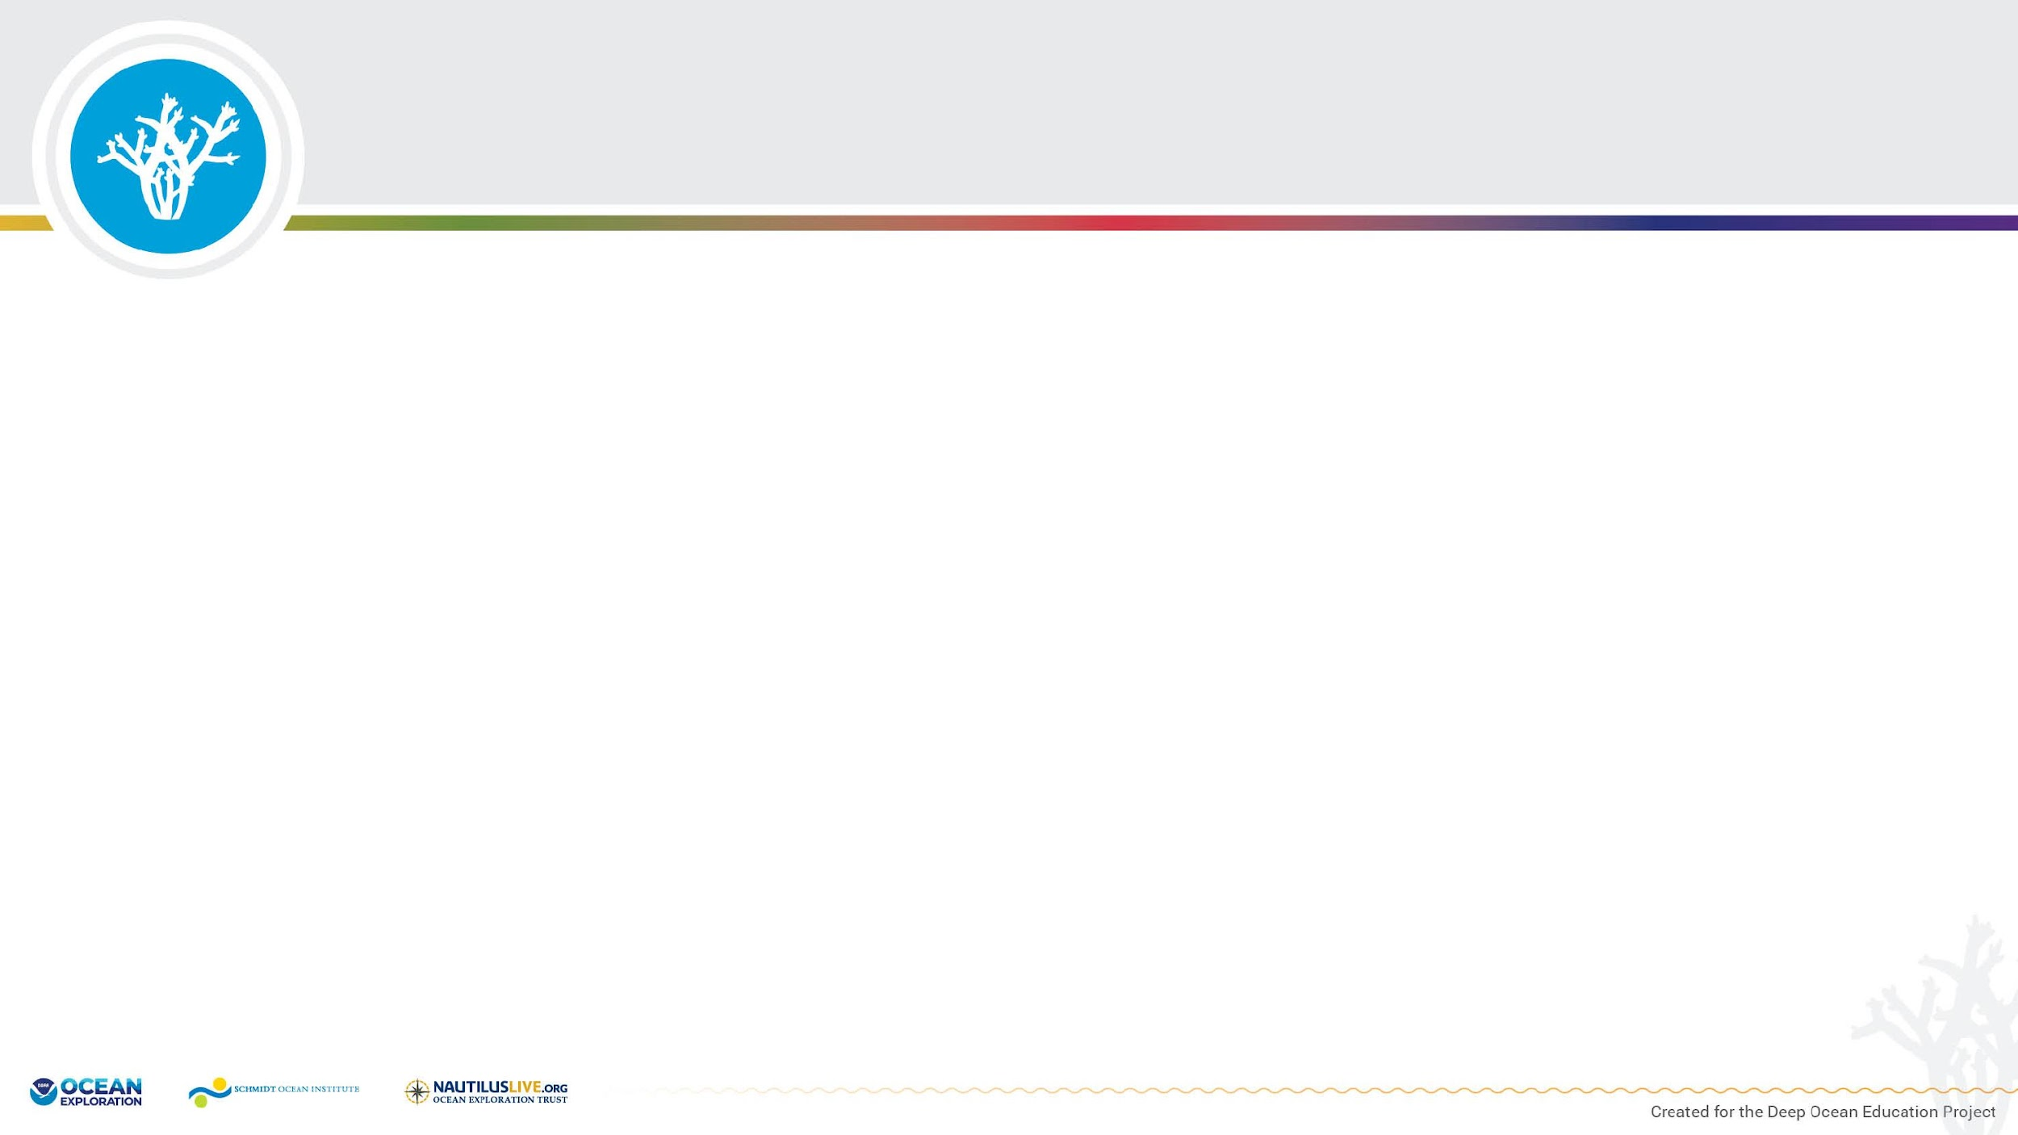
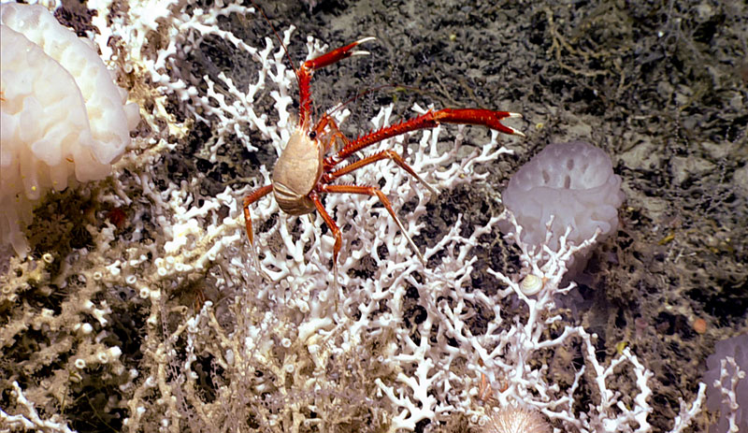
Dive site 7
Investigation:
Laying the Foundation for Deep-Sea Coral Gardens
Dive site 6

Slide 2
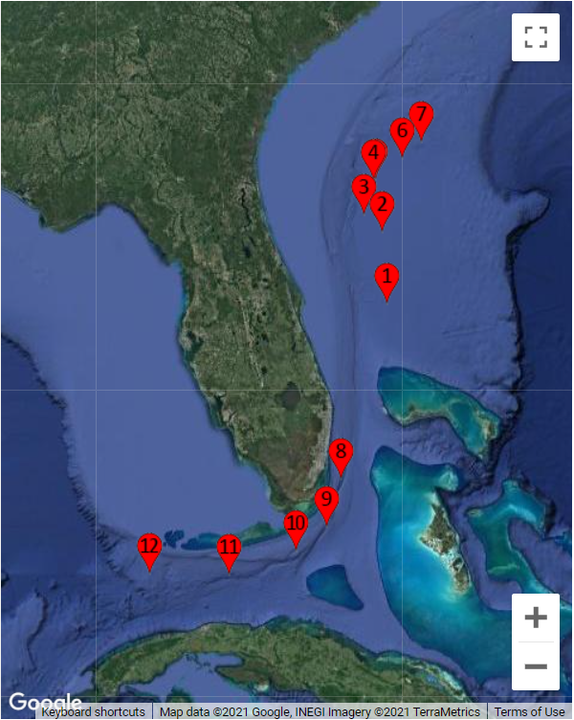
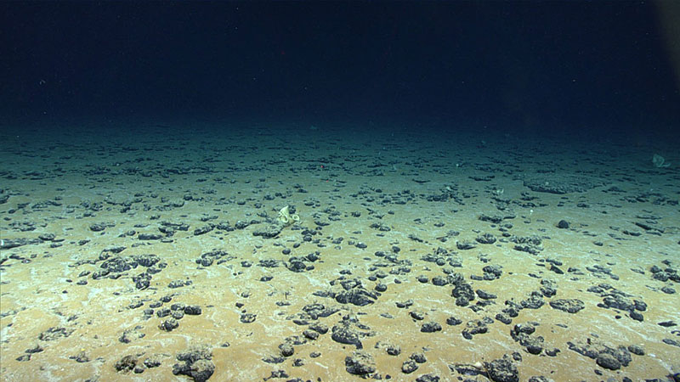
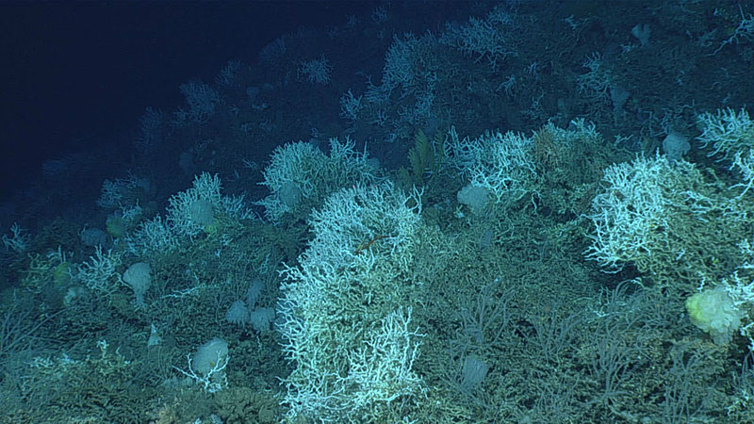
Experience the Phenomenon
NOAA Ocean Exploration 2019 Southeastern U.S. Deep-sea Exploration
Dive site 7
Dive site 6
The 2019 Southeastern U.S. Deep-sea Exploration Expedition included seafloor mapping and Remotely Operated Vehicle (ROV) dives (each dive numbered and indicated by the red markers) in the deep water habitats off the coast of South Carolina, Georgia, and Florida. https://oceanexplorer.noaa.gov/okeanos/explorations/ex1907/logs/summary/summary.html
Notes:
Map image captured from: https://oceanexplorer.noaa.gov/okeanos/explorations/ex1907/welcome.html
Dive 7 - Explored a sandy flat near an area historically subject to the use of experimental deep-sea mining https://oceanexplorer.noaa.gov/okeanos/explorations/ex1907/dailyupdates/nov7/nov7.html
Dive 6 - Remotely Operated Vehicle dive on an isolated coral mound near the center of the Blake Plateau: https://oceanexplorer.noaa.gov/okeanos/explorations/ex1907/dailyupdates/nov6/nov6.html

Slide 3
Experience the Phenomenon
Notice - Observations | Wonder - Questions

Slide 4
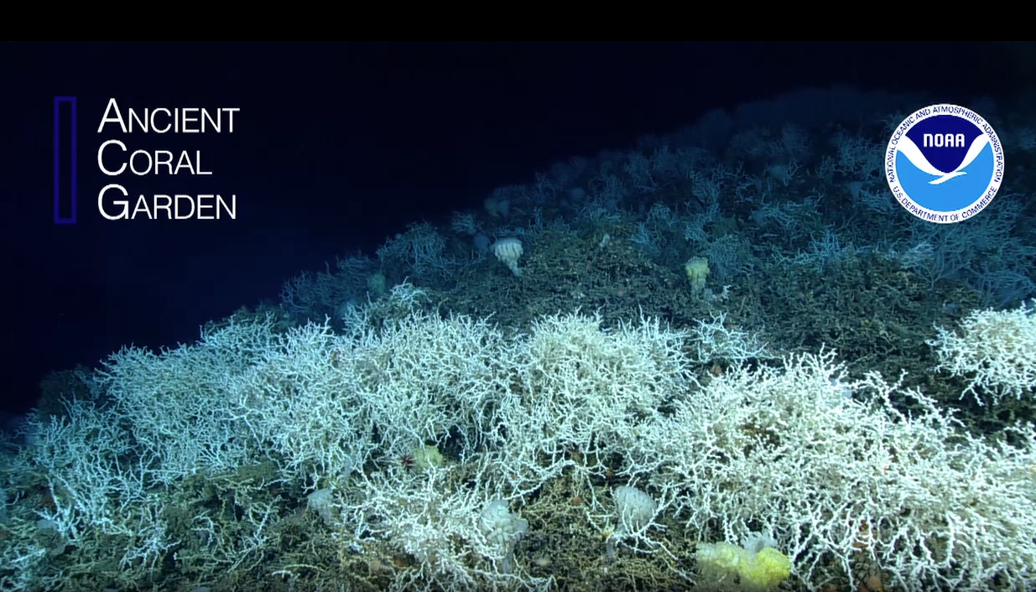
Experience the Phenomenon
https://archive.oceanexplorer.noaa.gov/okeanos/explorations/ex1907/dailyupdates/coral-garden/coral-garden-1280x720.mp4

Slide 5
Investigate
Student Worksheet: Lophelia pertusa Friends Graphic Organizer
ASSOCIATE SPECIES | HOW THE SPECIES BENEFITS | EVIDENCE FROM IMAGE
Shrimp | Shelter, protection from predators, access to food | The shrimp is crawling among live coral in a position where it could easily hide from a predator as it scavenges for its own food.

Slide 6
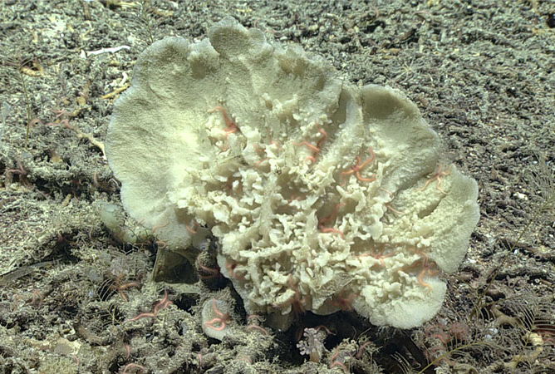
Demosponge
This large demosponge was observed growing on a coral mound in the deep waters off the coasts of South Carolina, Georgia, and Florida. Demosponges come in many shapes and sizes. Like other sponges, this species is a filter feeder and does best in areas where the currents can provide it with the food (particulate organic matter) it needs to survive.
Image courtesy of NOAA Ocean Exploration. https://archive.oceanexplorer.noaa.gov/okeanos/explorations/ex1907/logs/photolog/welcome.html#cbpi=/okeanos/explorations/ex1907/dailyupdates/nov6/media/demosponge.html
Notes:
NOAA Ocean Exploration 2019 Southeastern U.S. Deep-sea Exploration

Slide 7
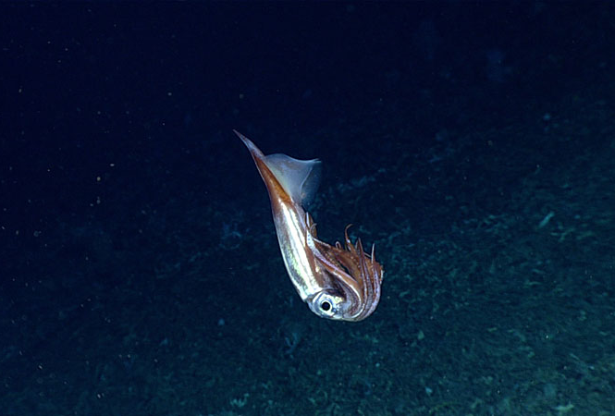
Bird Squid
This bird squid (Ornithoteuthis antillarum) was observed during a dive on an isolated coral mound in the deep waters off the coasts of South Carolina, Georgia, and Florida. The squid is holding its arms and tentacles close to its body, a likely defensive posture assumed in response to the remotely operated vehicle (ROV) in its deep-sea home.
Image courtesy of NOAA Ocean Exploration. https://archive.oceanexplorer.noaa.gov/okeanos/explorations/ex1907/logs/photolog/welcome.html#cbpi=/okeanos/explorations/ex1907/dailyupdates/nov6/media/squid.html
Notes:
NOAA Ocean Exploration 2019 Southeastern U.S. Deep-sea Exploration

Slide 8
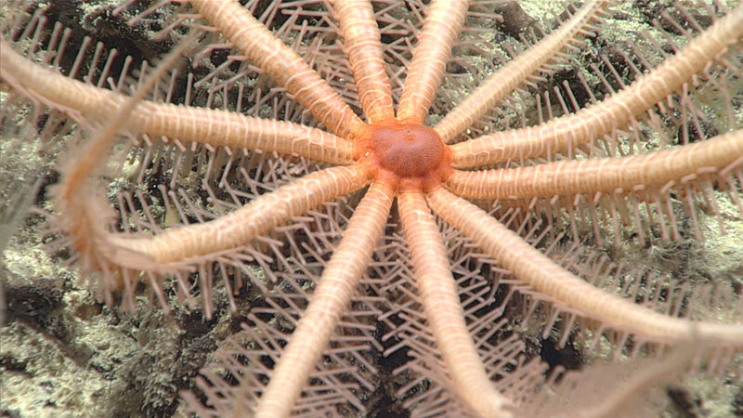
Brisingid Sea Star
This pink 12-armed animal is a brisingid sea star. The spines on its arms are covered with small, claw-like structures that it uses to catch small crustaceans as they swim by in the current. It then uses its tube feet to move its prey down to its mouth (at its center). This sea star was observed hanging out on a deep-sea coral mound located in the deep waters off the coast of South Carolina, Georgia, and Florida.
Image Courtesy of NOAA Ocean Exploration. https://archive.oceanexplorer.noaa.gov/okeanos/explorations/ex1907/logs/photolog/welcome.html#cbpi=/okeanos/explorations/ex1907/dailyupdates/nov6/media/seastar.html
Notes:
NOAA Ocean Exploration 2019 Southeastern U.S. Deep-sea Exploration

Slide 9
A Variety of Inhabitants
While exploring deep-sea coral mounds off the coast of South Carolina, Georgia, or Florida, scientists found large colonies of Lophelia pertusa deep-sea corals. The coral mounds were also home to high biodiversity, as is evident in this image, which features a variety of Lophelia pertusa inhabitants, including glass sponges, squat lobsters, a snail, an urchin, and more.
Image courtesy of NOAA Ocean Exploration. https://archive.oceanexplorer.noaa.gov/okeanos/explorations/ex1907/logs/photolog/welcome.html#cbpi=/okeanos/explorations/ex1907/dailyupdates/nov6/media/habitat.html
Notes:
NOAA Ocean Exploration 2019 Southeastern U.S. Deep-sea Exploration

Slide 10
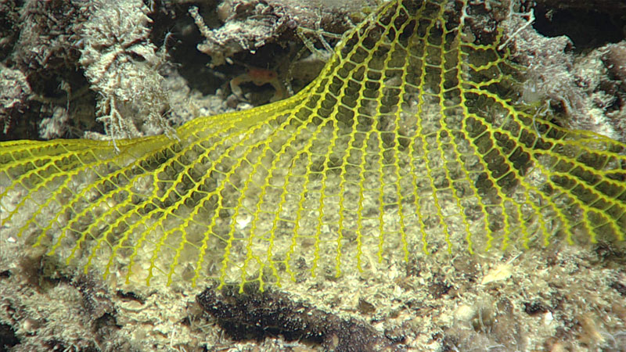
Yellow Mesh Fan
It’s not unusual to come across new species when we explore deep-sea areas that no one has ever been to before. This yellow mesh fan, spotted during a remotely operated vehicle (ROV) dive in the deep waters off the coasts of South Carolina, Georgia, and Florida, is actually an animal - not trash! Scientists were unable to identify the species through the camera, so they collected a sample for further analysis in the lab.
Image courtesy of NOAA Ocean Exploration. https://archive.oceanexplorer.noaa.gov/okeanos/explorations/ex1907/logs/photolog/welcome.html#cbpi=/okeanos/explorations/ex1907/dailyupdates/nov6/media/meshfan.html
Notes:
NOAA Ocean Exploration 019 Southeastern U.S. Deep-sea Exploration

Slide 11
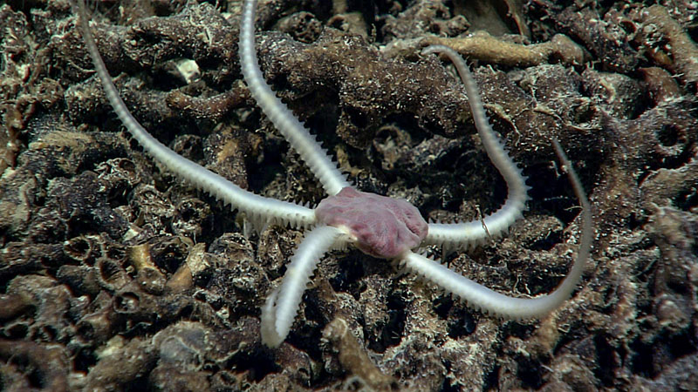
Brittle Star
During a remotely operated vehicle (ROV) dive in the Million Mounds Coral region off the coast of Florida, explorers spotted an abundance of spiky-armed brittle stars with pink central discs moving in the coral rubble. This one was collected from a depth of 822 meters (2,697 feet).
Image courtesy of NOAA Ocean Exploration. https://archive.oceanexplorer.noaa.gov/okeanos/explorations/ex2107/gallery/gallery.html#cbpi=/okeanos/explorations/ex2107/gallery/media/dive14-brittle-star.inc
Notes:
NOAA Ocean Exploration Windows to the Deep 2021

Slide 12
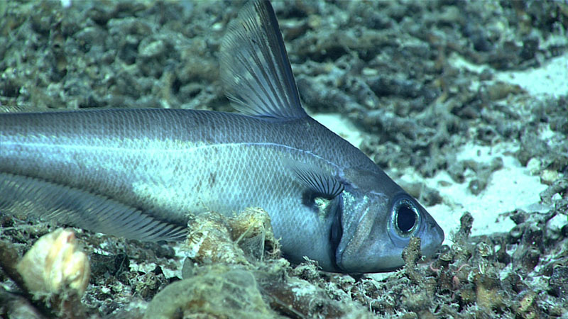
Rattail
Explorers observed many animals within the coral rubble in the Million Mounds coral region during dives with remotely operated vehicles (ROVs). This rattail fish was observed swimming around coral rubble at 822 meters (2,697 feet). During the dive, scientists saw several other species of fish, including cutthroat eels, cusk eels, and even a Darwin’s slimehead.
Image courtesy of NOAA Ocean Exploration. https://archive.oceanexplorer.noaa.gov/okeanos/explorations/ex2107/gallery/gallery.html#cbpi=/okeanos/explorations/ex2107/gallery/media/dive14-rattail.inc
Notes:
NOAA Ocean Exploration Windows to the Deep 2021

Slide 13
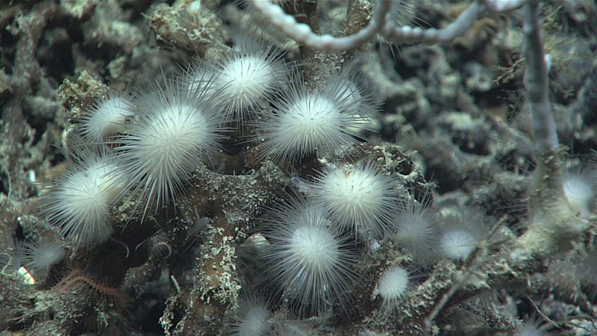
Carnivorous Sponges
This cluster of small, spiky sponges is in the family Cladorhizidae. Cladorhizids are carnivorous sponges that prey on animals such as small crustaceans. This cluster was imaged living on dead coral rubble in the deep waters off the coast of Florida at 825 meters (2,707 feet).
Image courtesy of NOAA Ocean Exploration. https://archive.oceanexplorer.noaa.gov/okeanos/explorations/ex2107/gallery/gallery.html#cbpi=/okeanos/explorations/ex2107/gallery/media/dive14-sponges.inc
Notes:
NOAA Ocean Exploration Windows to the Deep 2021

Slide 14
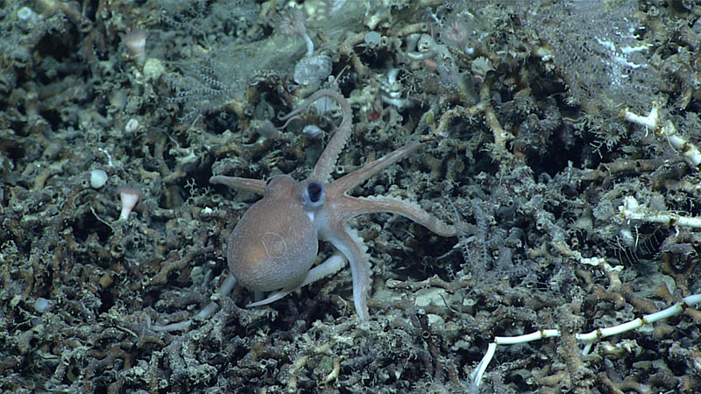
Juvenile Octopus
This juvenile octopus, Muusoctopus januarii, was observed exploring its surroundings on a small ridge of deep-sea coral reef mounds off the coasts of South Carolina and Georgia.
Image courtesy of NOAA Ocean Exploration. https://archive.oceanexplorer.noaa.gov/okeanos/explorations/ex2107/gallery/gallery.html#cbpi=/okeanos/explorations/ex2107/gallery/media/dive01-octopus.inc
Notes:
NOAA Ocean Exploration Windows to the Deep 2021

Slide 15
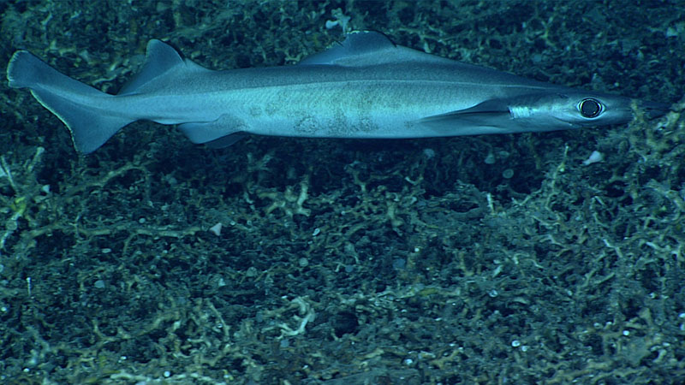
Birdbeak Dogfish Shark
A birdbeak dogfish shark was seen making its way over dead coral rubble that covered the seafloor for much of the first half of a remotely operated vehicle (ROV) dive on a small ridge of deep-sea coral mounds located off the coasts of South Carolina and Georgia. This shark, with its large eyes, was seen at a depth of approximately 860 meters (2,821 feet).
Image courtesy of NOAA Ocean Exploration. https://archive.oceanexplorer.noaa.gov/okeanos/explorations/ex2107/gallery/gallery.html#cbpi=/okeanos/explorations/ex2107/gallery/media/dive01-shark.inc
Notes:
NOAA Ocean Exploration Windows to the Deep 2021

Slide 16
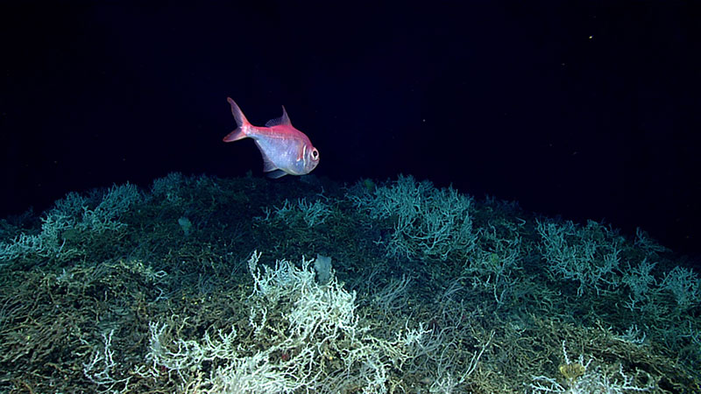
Alfonsino Fish
Alfonsino fish are a commercially important species. This fish was seen swimming over a thicket of Lophelia pertusa during a remotely operated vehicle (ROV) dive on a cold water deep-sea coral mound located off the coasts of South Carolina, Georgia, and Florida.
Image courtesy of NOAA Ocean Exploration. https://archive.oceanexplorer.noaa.gov/okeanos/explorations/ex1903/logs/photolog/welcome.html#cbpi=/okeanos/explorations/ex1903/logs/july9/media/fish.html
Notes:
NOAA Ocean Exploration Windows to the Deep 2019

Slide 17
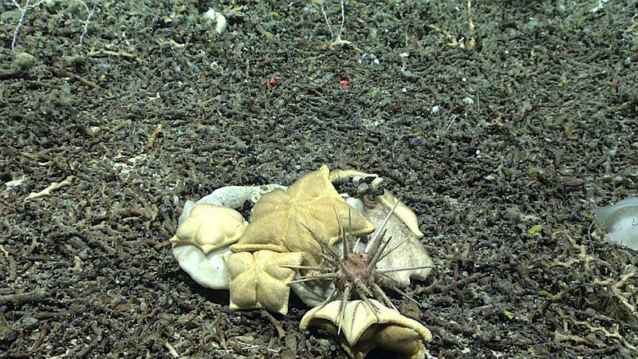
Cidaroid Sea Urchin
While exploring deep-sea coral mounds off the coasts of the Southeastern United States explorers observed a massive sea urchin, from the order Cidaroida, and at least six other individuals. A number of sea stars called cookie stars (Plinthaster dentatus) were also observed feeding on a sponge.
Image courtesy of NOAA Ocean Exploration. https://archive.oceanexplorer.noaa.gov/okeanos/explorations/ex1903/logs/photolog/welcome.html#cbpi=/okeanos/explorations/ex1903/logs/july4/media/feeding.html
Notes:
NOAA Ocean Exploration Windows to the Deep 2019

Slide 18
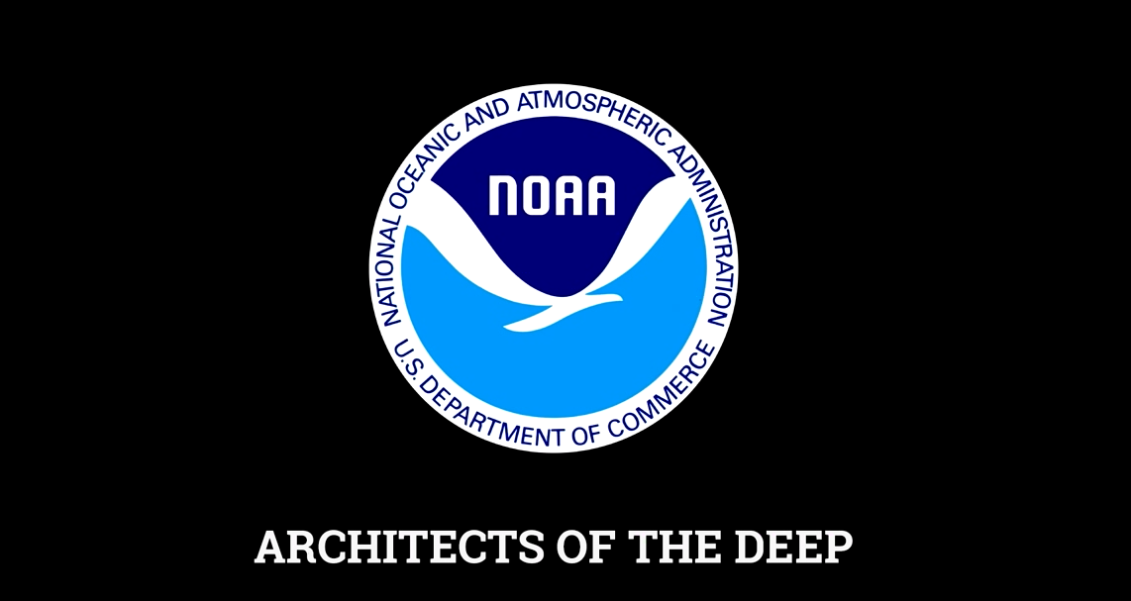
Put the Pieces Together
https://archive.oceanexplorer.noaa.gov/okeanos/explorations/ex1711/dailyupdates/media/video/architects/architects-1280x720.mp4

Slide 19
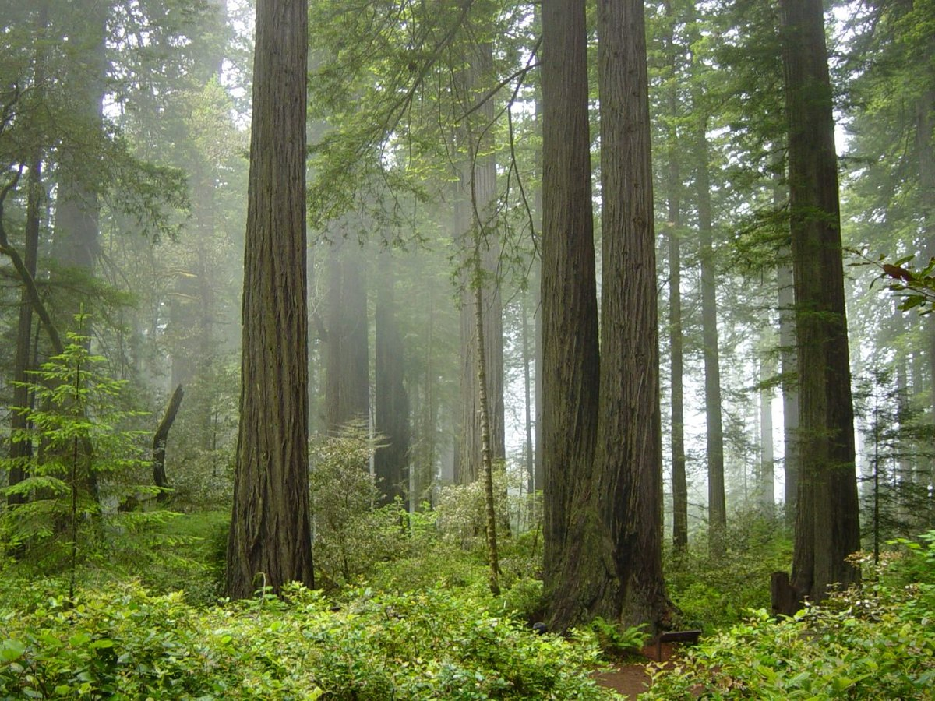
Laying the Foundation: Redwoods
Coast Redwood forest and understory plants in Redwood National Park, California
Environment:
Coastal forests of Northern California
Effects
Coexist with various hardwoods that differ from coastal to inland side of forest
Provide habitat for many mammals, birds, insects, and other organisms
Image from: https://commons.wikimedia.org/wiki/File:Redwood_National_Park,_fog_in_the_forest.jpg
Information from:
https://esajournals.onlinelibrary.wiley.com/doi/pdf/10.1890/1540-9295%282005%29003%5B0479%3ALOFSCF%5D2.0.CO%3B2
Notes:
Image from: https://commons.wikimedia.org/wiki/File:Redwood_National_Park,_fog_in_the_forest.jpg
Information from: https://esajournals.onlinelibrary.wiley.com/doi/epdf/10.1890/1540-9295%282005%29003%5B0479%3ALOFSCF%5D2.0.CO%3B2

Slide 20
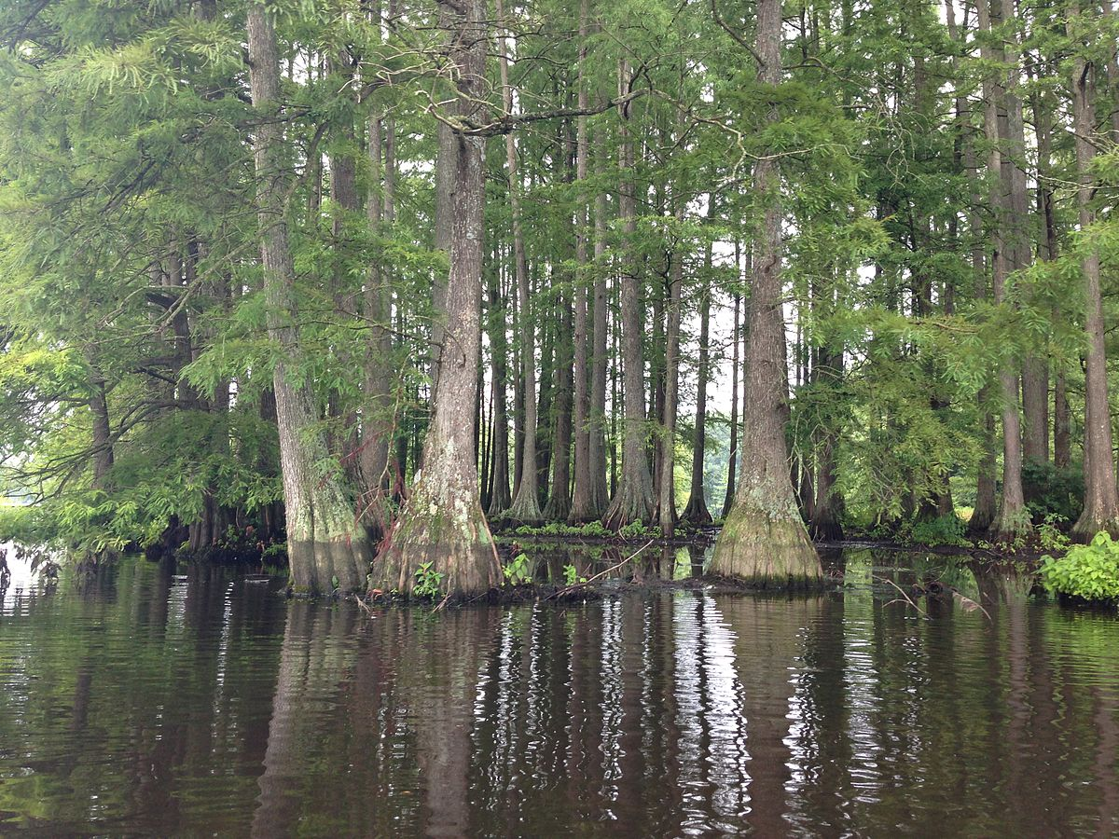
Laying the Foundation: Bald Cypress
Cluster of bald cypress trees in Trap Pond State Park near Laurel, Delaware
Environment:
Found in deepwater swamps of southeastern North America
Effects:
Regulate the water table level and flow of sediment and nutrients
Control structure and composition of associated plant and animal communities
Image from: https://commons.wikimedia.org/wiki/File:Bald_Cypress.JPG
Information from: https://esajournals.onlinelibrary.wiley.com/doi/epdf/10.1890/1540-9295%282005%29003%5B0479%3ALOFSCF%5D2.0.CO%3B2
Notes:
Image from: https://commons.wikimedia.org/wiki/File:Bald_Cypress.JPG
Information from: https://esajournals.onlinelibrary.wiley.com/doi/epdf/10.1890/1540-9295%282005%29003%5B0479%3ALOFSCF%5D2.0.CO%3B2

Slide 21
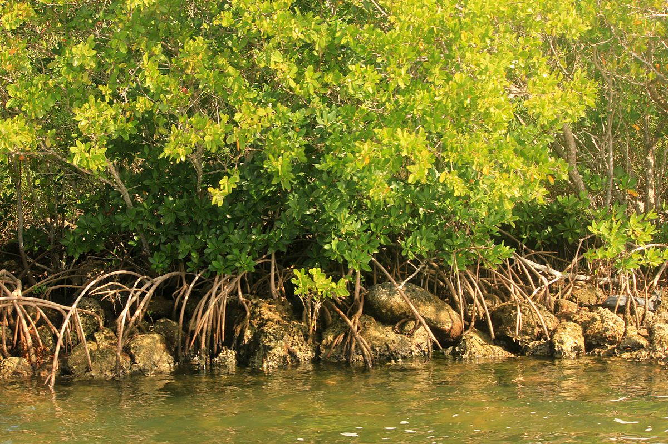
Laying the Foundation: Mangroves
Mangroves and roots in Biscayne National Park in Florida
Environment:
Estuarine and coastal forests throughout the tropics
Effects:
Extremely high net primary productivity
Slow movement of tidal waters stabilize shoreline
Provides habitat for fish and other species
Image from: https://commons.wikimedia.org/wiki/File:Gfp-florida-biscayne-national-park-mangroves.jpg
Information from: https://esajournals.onlinelibrary.wiley.com/doi/epdf/10.1890/1540-9295%282005%29003%5B0479%3ALOFSCF%5D2.0.CO%3B2 and https://oceanservice.noaa.gov/facts/mangroves.html
Notes:
Image from: https://commons.wikimedia.org/wiki/File:Gfp-florida-biscayne-national-park-mangroves.jpg
Information from: https://esajournals.onlinelibrary.wiley.com/doi/epdf/10.1890/1540-9295%282005%29003%5B0479%3ALOFSCF%5D2.0.CO%3B2 and https://oceanservice.noaa.gov/facts/mangroves.html

Slide 22
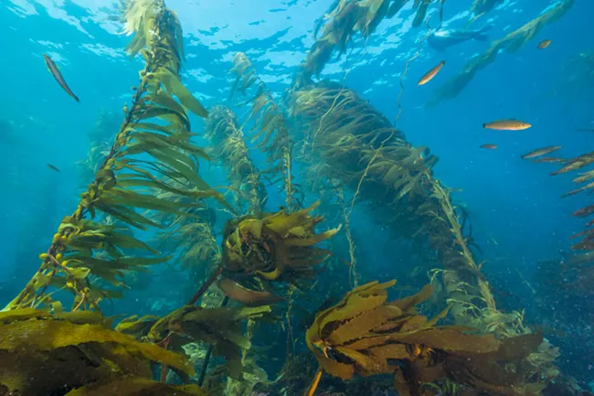
Laying the Foundation: Kelp Forest
Kelp Forest in Channel Islands National Marine Sanctuary
Environment:
Seaweed forest off the western coast of the U.S.
Effects:
Acts as natural breakwater, protecting the coastline
Provides habitat that provides food, shelter and protection for a wide variety of marine species
Provides spawning and nursery grounds for fish and other marine life
Image from: https://www.nps.gov/chis/learn/nature/kelp-forests.htm
Information from: https://www.nps.gov/chis/learn/nature/kelp-forests.htm
Notes:
Image from: https://www.nps.gov/chis/learn/nature/kelp-forests.htm
Information from: https://www.nps.gov/chis/learn/nature/kelp-forests.htm

Slide 23
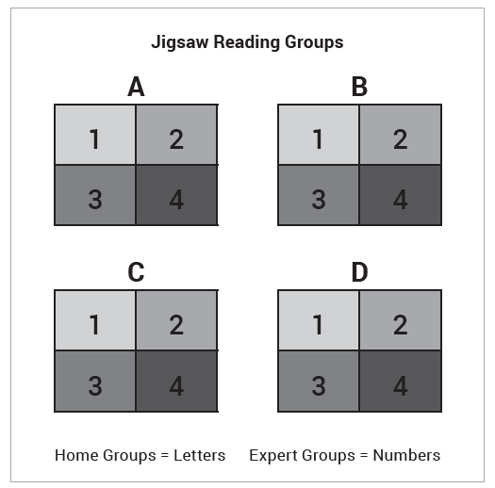
Put the Pieces Together (Expert Reading Jigsaw)

Slide 24
Put the Pieces Together (Expert Reading Jigsaw)
Student Worksheet: Foundation Species Graphic Organizer
Characteristics of Lophelia pertusa
Benefits of Lophelia pertusa to other species
Leads to
Write a three to five sentence explanation for how Lophelia pertusa coral acts as a foundation species in deep-sea coral communities.

Slide 25
Put the Pieces Together
Foundation Species Graphic Organizer (Look fors)
Characteristics of Lophelia pertusa
Living coral has a highly branching structure Dead coral rubble provides a harder surface than bottom sediments Rubble forms mounds that rise above the seafloor Living coral reaches up above the mound surface Rubble also provides many small openings (“nooks and crannies”) Lophelia pertusa corals filter feed on organic matter falling from the water column above (or within currents rushing by). This allows them to serve as the base of a food web even at depths where little to no light is available.
Benefits of Lophelia pertusa to other species
Mound structure and vertical structure of corals lifts other organisms into currents, which provide nutrients and removes sediments Coral branches provide shelter, habitat, and anchor points for many organisms, including other filter feeders and multiple levels of predators Harder rubble surface provides an attachment point for species like sponges Some species feed directly on living coral
Leads to

Slide 26
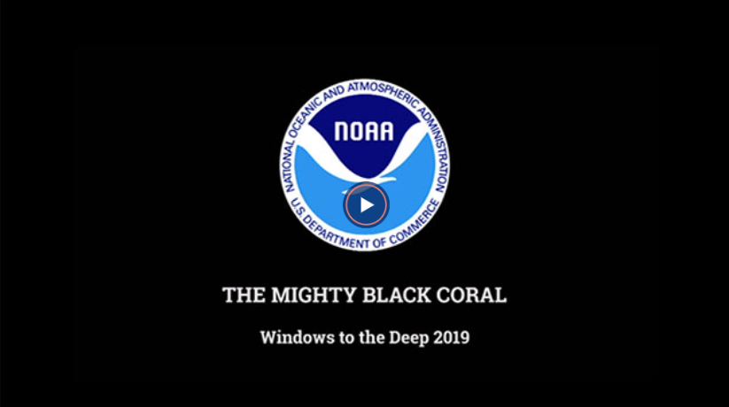
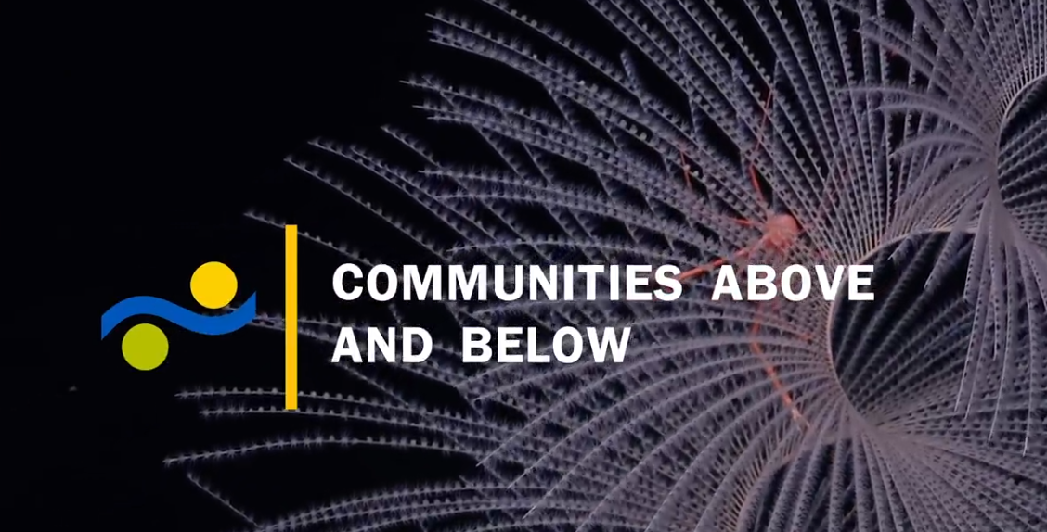
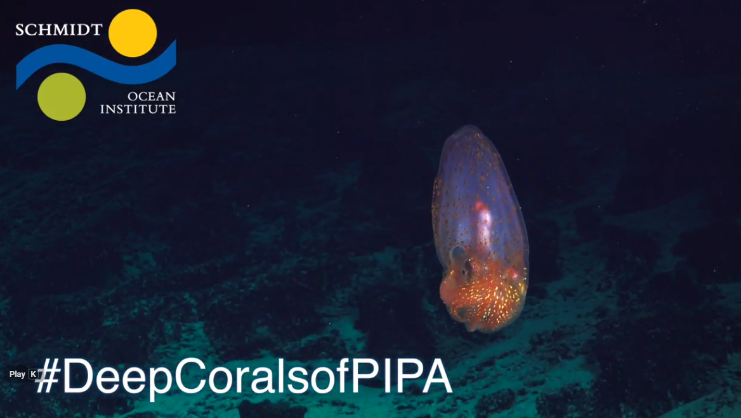
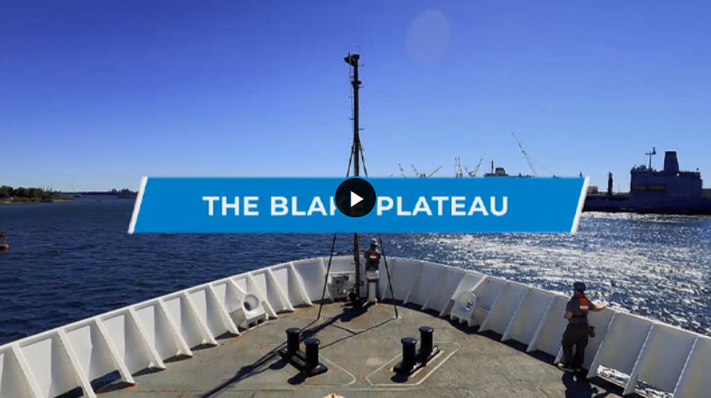
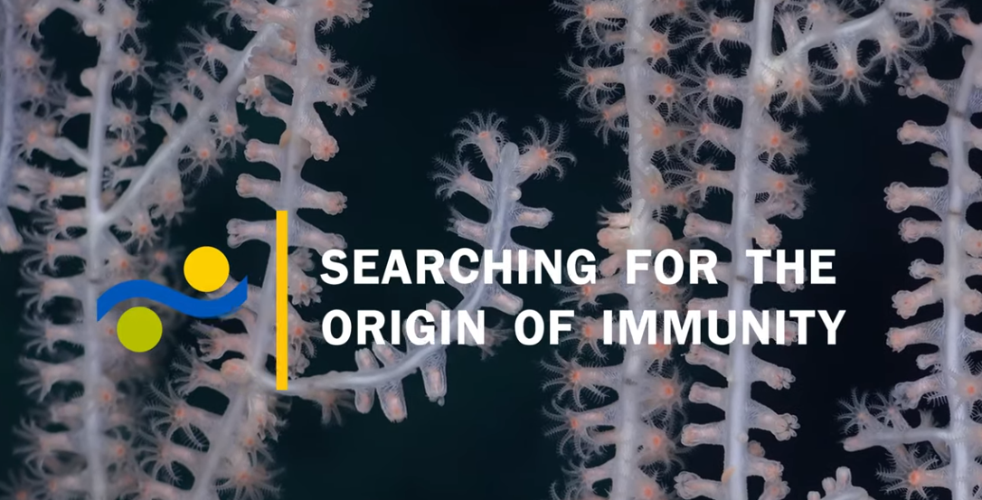
Wrap Up Videos
Notes:
The Mighty Black Coral (video): https://oceanexplorer.noaa.gov/okeanos/explorations/ex1903/dailyupdates/june22/media/black-coral-log.html
Discovering Deep-Sea Corals of the Phoenix Islands 2 - Communities Above and Below (video): https://www.youtube.com/watch?v=Ud3A8YJEvLI
Discovering Deep Sea Corals of the Phoenix Islands 2 - Searching for the Origin of Immunity (video): https://www.youtube.com/watch?v=pI0OPerCq8w
The Blake Plateau (video): https://archive.oceanexplorer.noaa.gov/okeanos/explorations/ex2107/gallery/gallery.html#cbpi=/okeanos/explorations/ex2107/gallery/media/blake-plateau.inc
Deep Corals of PIPA (video): https://schmidtocean.org/cruise-log-post/deep-corals-pipa-wrap-video/

Slide 27
Extension
Foundation Species Graphic Organizer: _______________________(chosen species)
Characteristics of My Chosen Species
Benefits of My Chosen Species to other species
Leads to

