Slide 1
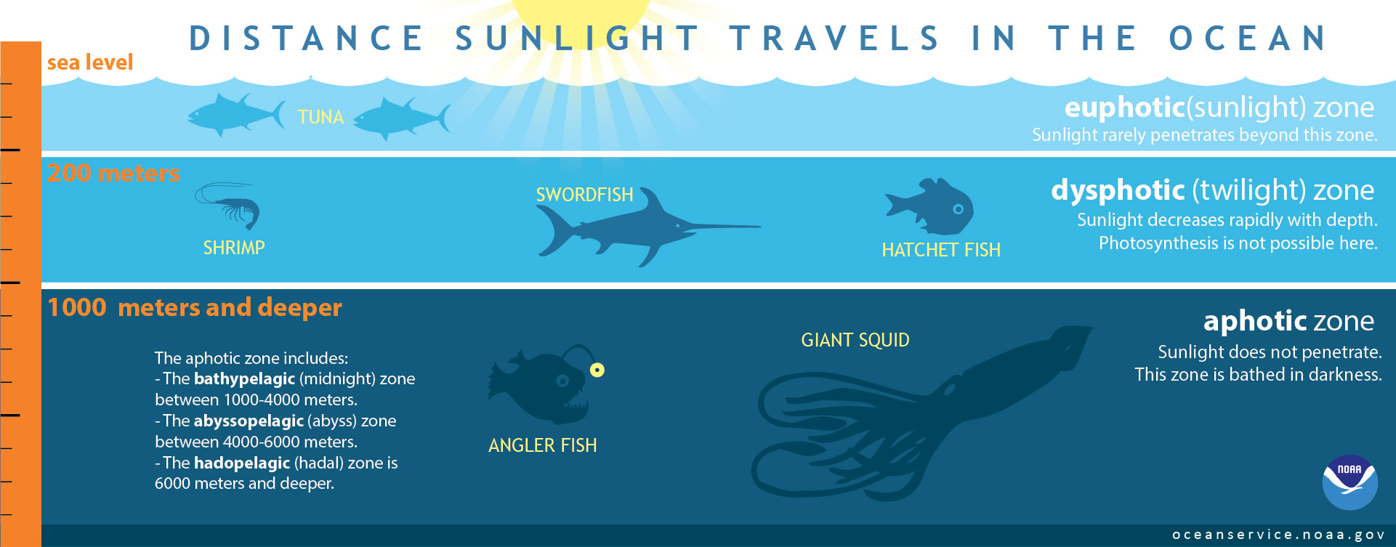

Slide 2
Think About It!
Plant, animal, bacteria, fungus, etc.
What kind of organism is it? What is your evidence? Where in the ocean do you think it lives? What makes you think that? What adaptations (physical or behavioral) might help it to survive in this environment? Describe them. How might it get food? How might it eat? How might it defend itself or avoid being eaten? How might it find a mate? What questions do you have about the organism?

Slide 3
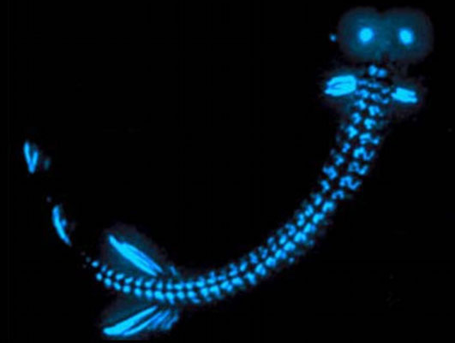
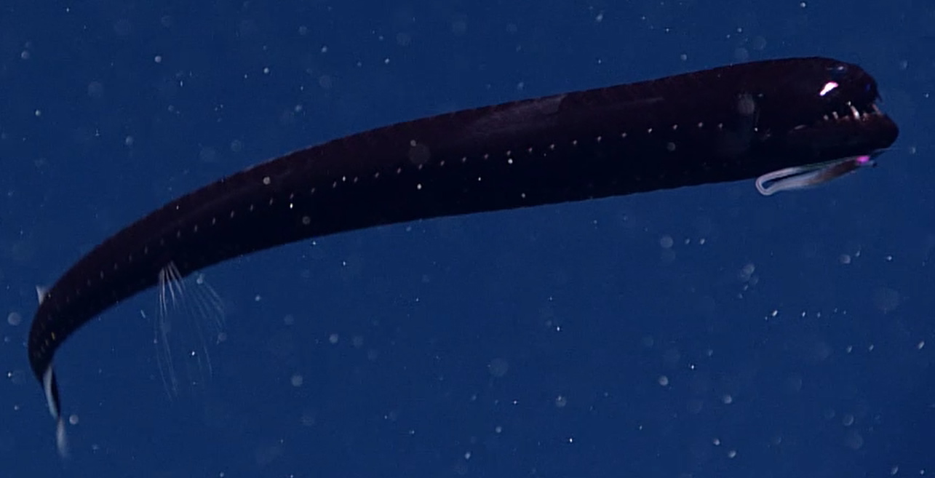
Organism A
We will need high-res versions of the images suitable for printing. An image with external illumination would also be helpful. Is it a dragonfish?
Image courtesy NOAA Ocean Exploration: https://oceanexplorer.noaa.gov/okeanos/explorations/ex1907/dailyupdates/nov4/media/dive04-dragonfish-1280x720.mp4 (video)
Image copyright E. Widder: https://oceanexplorer.noaa.gov/edu/themes/images/biolum_thumb.jpg

Slide 4
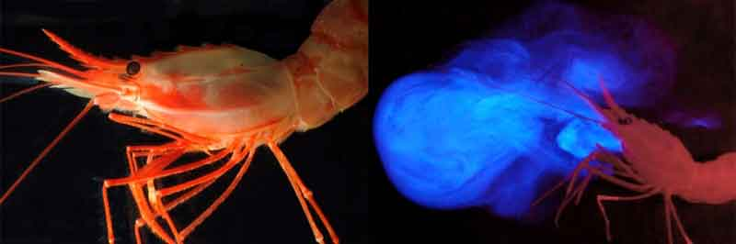
Organism B
Image courtesy Sönke Johnsen and Katie Thomas, NOAA Ocean Exploration: https://oceanexplorer.noaa.gov/facts/media/bioluminescence-800.jpg

Slide 5
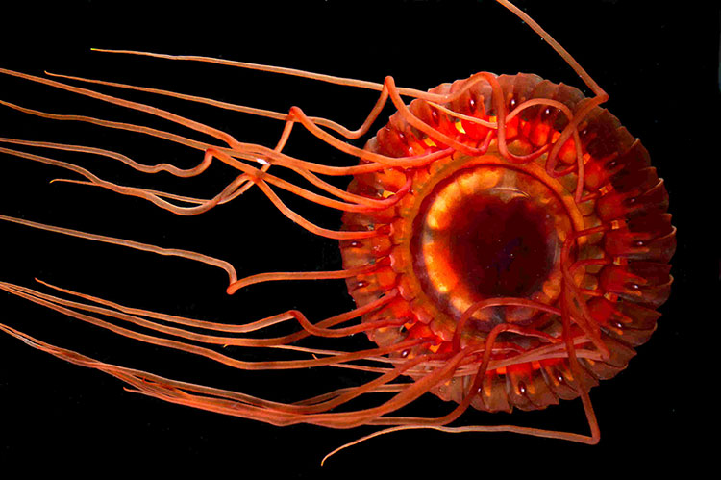
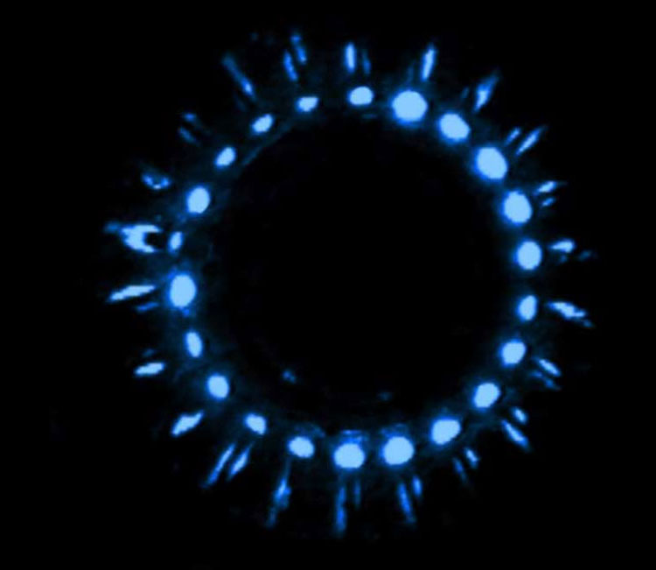
Organism C
Images courtesy E. Widder: https://oceanexplorer.noaa.gov/explorations/15biolum/background/medusa/medusa.html

Slide 6
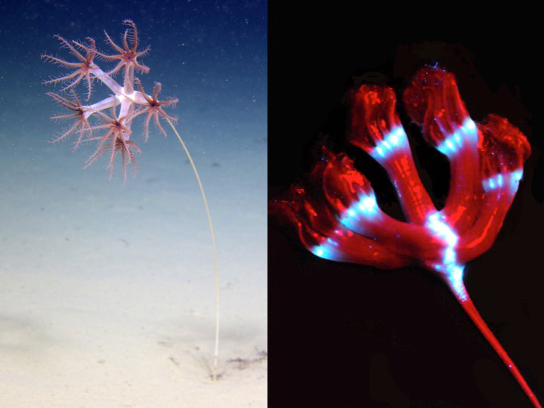
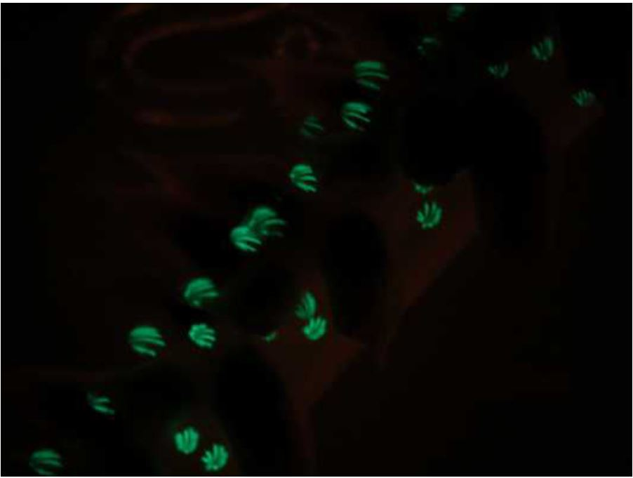
Organism D
Image courtesy NOAA Ocean Exploration: https://oceanexplorer.noaa.gov/explorations/15biolum/logs/july23/media/figure_5_hires.jpg
Image courtesy NOAA Ocean Exploration: https://oceanexplorer.noaa.gov/explorations/09bioluminescence/background/bioluminescence/media/seapendk0111_600.jpg

Slide 7
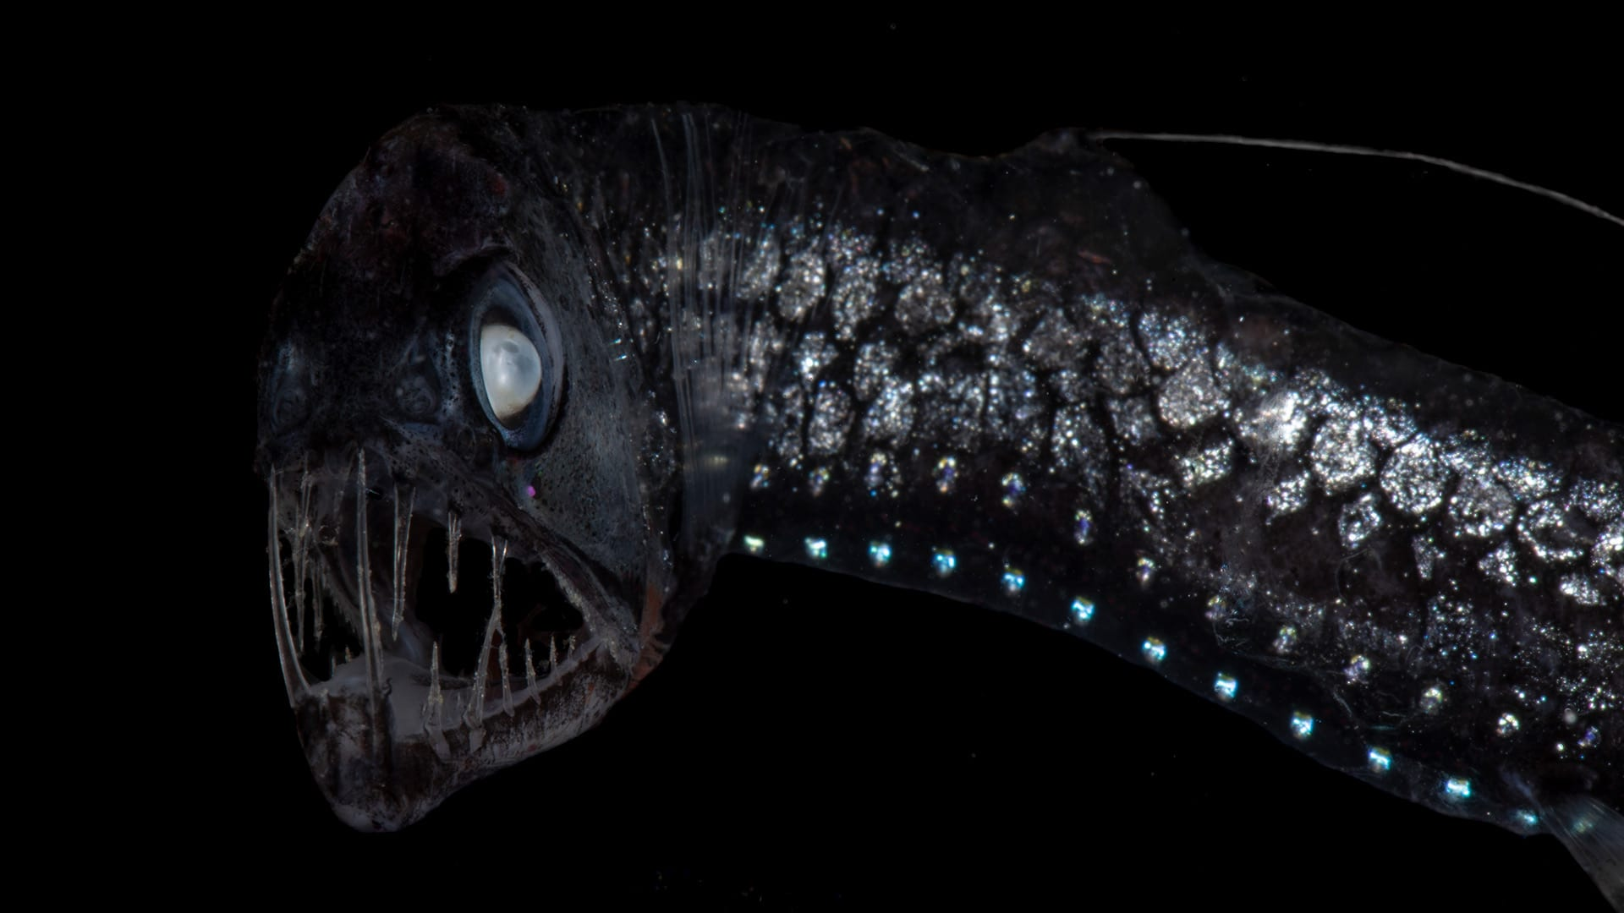
Organism E
Image courtesy Paul Caiger, ©Woods Hole Oceanographic Institution: https://www.whoi.edu/news-insights/content/fish-with-flashlights/

Slide 8
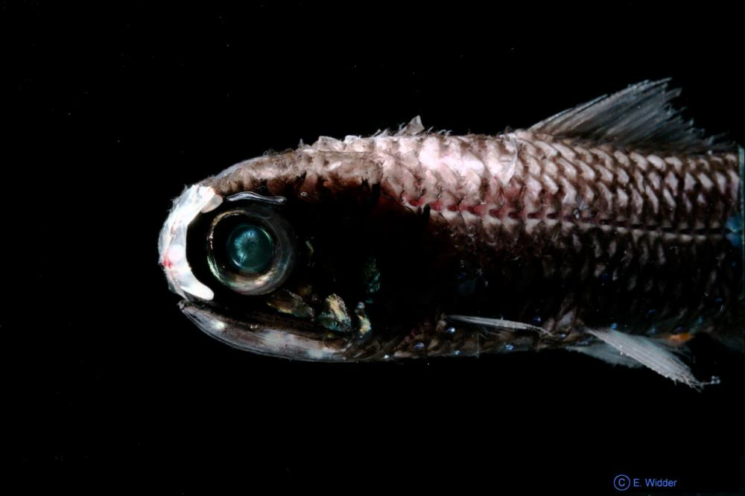
Organism F
Image courtesy E. Widder, ORCA, www.teamorca.org: https://ocean.si.edu/ocean-life/fish/bioluminescence

Slide 9
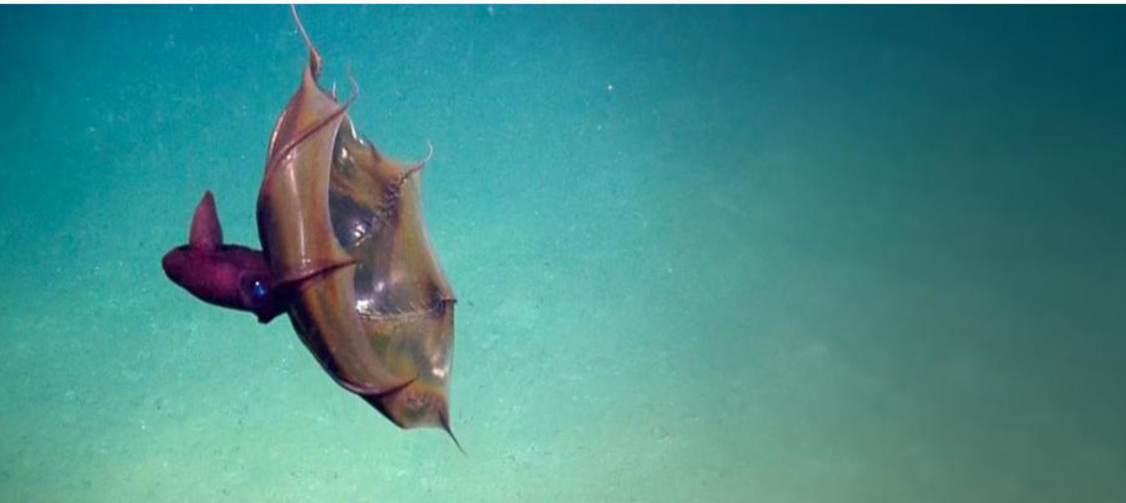
Organism G
Image courtesy Ocean Exploration Trust - Nautilus Live: https://www.youtube.com/watch?v=4e4PvKK_lMU (video)

Slide 10
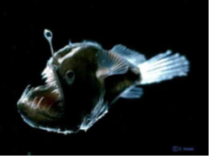
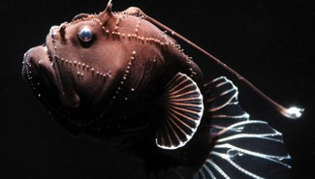
Organism H
Image courtesy Edie Widder, NOAA Ocean Today:
https://oceantoday.noaa.gov/bioluminescentocean/ (video)
Image courtesy Woods Hole Oceanographic Institution: https://twilightzone.whoi.edu/explore-the-otz/creature-features/anglerfish/

Slide 11
Dragonfish
We will need high-res versions of the images suitable for printing. An image with external illumination would also be helpful. Is it a dragonfish?
The dragonfish is in the genus Melanostomias (Melano = latin for black or dark color, stomias = large mouth).
Found throughout the North Atlantic Ocean at depths ranging from 50 to 1500 meters (about 164 to 4921 feet), these fish are small (~15-26 cm/6-10 in) but they are considered apex predators.
They have fang-like teeth and an enormous jaw that can open to more than 100 degree, allowing them to consume prey much larger than themselves!
Notice the parallel rows of light-producing organs. These are called photophores. Notice the glowing barbel under the fish’s chin.
Image courtesy NOAA Ocean Exploration: https://oceanexplorer.noaa.gov/okeanos/explorations/ex1907/dailyupdates/nov4/media/dive04-dragonfish-1280x720.mp4 (video)
Image copyright E. Widder: https://oceanexplorer.noaa.gov/edu/themes/images/biolum_thumb.jpg

Slide 12

Deep-sea Shrimp
Image courtesy Sönke Johnsen and Katie Thomas, NOAA: https://oceanexplorer.noaa.gov/facts/media/bioluminescence-800.jpg
The deep-sea shrimp Heterocarpus ensifer (Hetero= Latin for different; carpus = bones) is found in the Atlantic Ocean and Caribbean Sea, with subspecies found in the Pacific.
They can spew bioluminescent material from glands located near their mouth.

Slide 13
Atolla Jellyfish
Found in the deep ocean across the globe, the Atolla jellyfish, Atolla wyvillei, is red in color and small in size (~2-74 cm/~1-5 in). When disturbed the jelly displays a bright, flashing circle of blue light.
These small jellies have been found in the ocean “Midnight Zone.”
Images courtesy E. Widder: https://oceanexplorer.noaa.gov/explorations/19biolum/background/medusa/media/figure-2-250.jpg

Slide 14
Sea Pen
Image courtesy NOAA Ocean Exploration: https://oceanexplorer.noaa.gov/explorations/15biolum/logs/july23/media/figure_5_hires.jpg
Image courtesy NOAA Ocean Exploration: https://oceanexplorer.noaa.gov/explorations/09bioluminescence/background/bioluminescence/media/seapendk0111_600.jpg
Sea pens are cnidarians, and are related to jellyfish, anemones and corals. They are colonial animals composed of multiple polyps, each with eight tentacles that capture tiny prey and floating matter. Some sea pens emit bioluminescent light like this one seen during a NOAA Ocean Exploration expedition.
The sea pen can create flashes of light that travel up and down its stem.

Slide 15
Viperfish
The viperfish is a species of dragonfish that lurks at depths of 200-1000 meters. Though small in size (6-26 cm/~2.5-10 in), it has long fangs and the ability to unhinge its skull and expand its stomach, allowing it to swallow prey 60% bigger than itself! This fish also has a glowing light on its adapted dorsal fin ray that hangs in front of its mouth.
And, like many fishes of the deep sea, the viperfish has bioluminescent photophores on its underside and can flash blue-green or yellow light.
Image courtesy Paul Caiger, ©Woods Hole Oceanographic Institution: https://www.whoi.edu/news-insights/content/fish-with-flashlights/

Slide 16
Lanternfish
Lanternfishes are small fish (2-30 cm/~1-12 in) thought to make up a huge amount of the deep-sea fish biomass and are found worldwide. Generally, they live at depths 300 – 1500 meters down, but these fishes migrate to shallower water to feed at night. This is called diel vertical migration.
Different species of lanternfish have different arrangements of photophores, some being on the sides of their bodies, some on their head, some on their tail. The patterns may even vary between males and females. They can shine as blue, green or yellow light. This lanternfish even has a nasal light organ!
Image courtesy E. Widder, ORCA, www.teamorca.org: https://ocean.si.edu/ocean-life/fish/bioluminescence

Slide 17
Vampire Squid
Vampire squid inhabit the extreme environment of the deep ocean. They’ve adapted to the waters of the “Midnight Zone”, below 1000 meters, far deeper than sunlight can reach. Their bright red eyes and dark color earned them the mythical name. Those eyes are actually the largest proportionally of any animal, relative to its small size (~30 cm/~12 in). Pale red in color, it is also almost completely covered in photophores, which produce flashes of light.
These creatures have the ability to release large clouds of bioluminescent mucus.
Image courtesy Ocean Exploration Trust - Nautilus Live: https://www.youtube.com/watch?v=4e4PvKK_lMU (video)

Slide 18
Anglerfish
Image courtesy Edie Widder, NOAA Ocean Today:
https://oceantoday.noaa.gov/bioluminescentocean/ (video)
Image courtesy Woods Hole Oceanographic Institution: https://twilightzone.whoi.edu/explore-the-otz/creature-features/anglerfish/
Female deep-sea anglerfish grow up to about 20 cm (~8 in) while the males are much smaller (2.8 cm/~1 in) The females of some species of anglerfish have a symbiotic relationship with bioluminescent bacteria that make a home in the barbel that hangs from the tip of an elongated dorsal spine on the fish’s head.

